Slide 1
Introduction to Physical Disabilities
August 2026

Slide 2
Learning Objectives
After completing this course, participants will be able to:
  List common physical disabilities in people served by APS
  Describe common communication differences that may occur in individuals with physical disabilities
  Explain factors that put the population of people with disabilities at disproportionate risk of abuse or neglect
  List best practices to conduct more effective interviews with people with physical disabilities
  Describe strength-based service planning considerations for people with physical disabilities

Slide 3
Introductions

Slide 4
The Population We Can All Join
Disability: a condition that limits our ability to engage in the activities of our daily lives.
Physical Disability: a wide range of conditions that limit a person’s ability to move, coordinate, or use parts of their body.
Examples:
Blindness or vision loss
Loss of limb or mobility
Arthritis
Spinal cord injury
Multiple Sclerosis (MS)
Cerebral Palsy
ALS (Lou Gehrig’s disease)
Parkinson’s
(Centers for Disease Control and Prevention, 2025)

Slide 5
What You Might See
People may have reduced mobility or motor control
People may get fatigued faster or live with chronic fatigue
Progression of disabilities over time
Health changes that come with aging interact with disabilities
People may use assistive devices or receive assistance from others

Slide 6
What You Might Hear
People may be making their best guess about:
  Physical ability
  Decision-making ability
  Cognitive ability

Slide 7
The Stories We Tell
What are some narratives about physical disabilities that we should challenge?
(Dunn, 2021)

Slide 8
Truths About Barriers
What are barriers that impact people with physical disabilities?

Slide 9
Accessibility Mitigates Barriers
Accessible design, tools, and considerations can benefit a wide range of people, not just those with physical disabilities.
You don’t need to know someone lives with a disability to identify an accessible tool that might support them.
The goal is to preserve or promote independence.

Slide 10
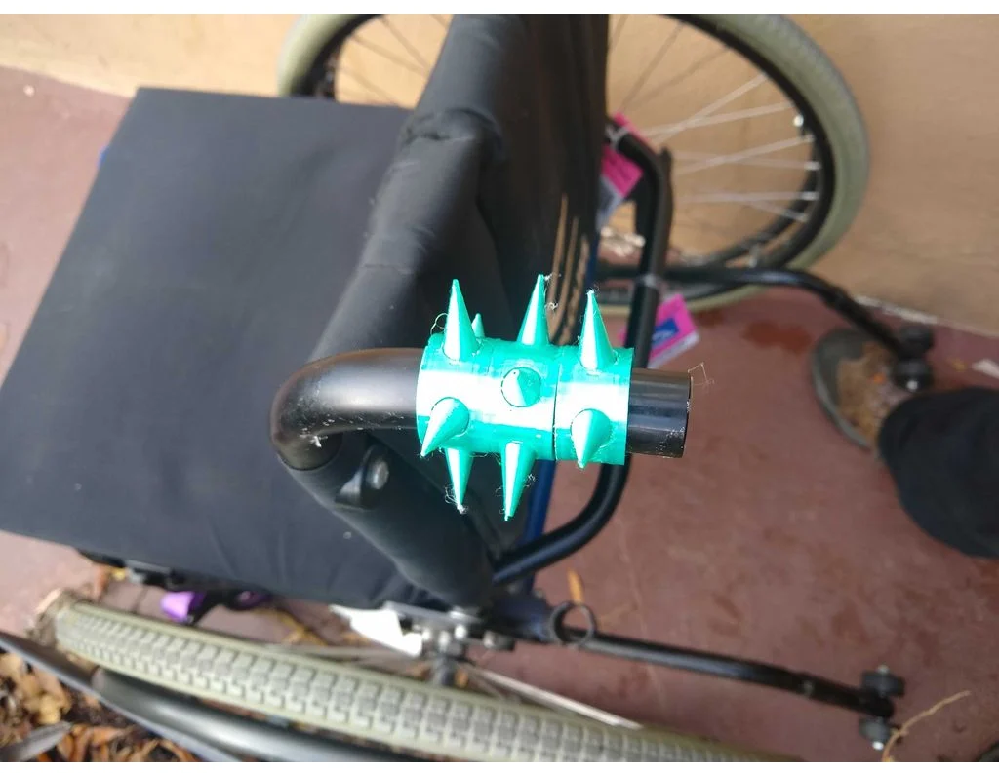
Independence and Autonomy
Independence and autonomy are linked, but not the same
Asserting autonomy is a matter of safety
Autonomy may be infringed by people who believe they are trying to help
WheelChair Defense Spikes
by DudeImaMage is licensed under the Creative Commons - Attribution license.

Slide 11
Disability Etiquette
Get to know people as individuals
Presume competence
Do not touch accessibility devices or service animals
Respectful conversation
Maintain appropriate physical distance
Get comfortable talking about disability
Person-First Language
(Disability:IN, n.d.)

Slide 12
Person-First or Not? 1 of 4
The disabled are such an inspiring population.

Slide 13
Person-First or Not? 2 of 4
He suffers from advanced arthritis.

Slide 14
Person-First or Not? 3 of 4
She had her leg amputated following a severe infection.

Slide 15
Person-First or Not? 4 of 4
She’s been bedridden for years.

Slide 16
To Recap
Not Person-First
Person-First
The disabled
Being “inspiring” just for living
Victim of, suffers from
Wheelchair-bound, bedfast
“Became an amputee”
Identity-first (Deaf, Autistic)
People with disabilities
Lives with, has a disability
Uses a wheelchair, stays in bed
Has a limb amputated
Has hearing loss, someone who is deaf, person with autism

Slide 17
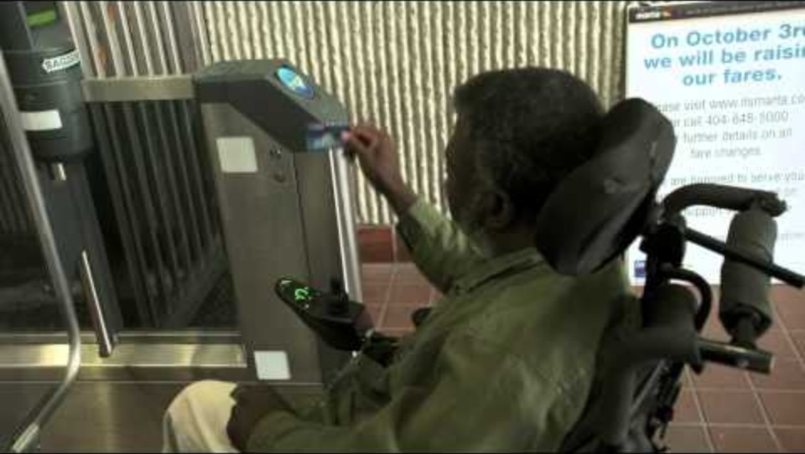
Bernard Video
CDC Video: “What’s Disability to Me?”

Slide 18
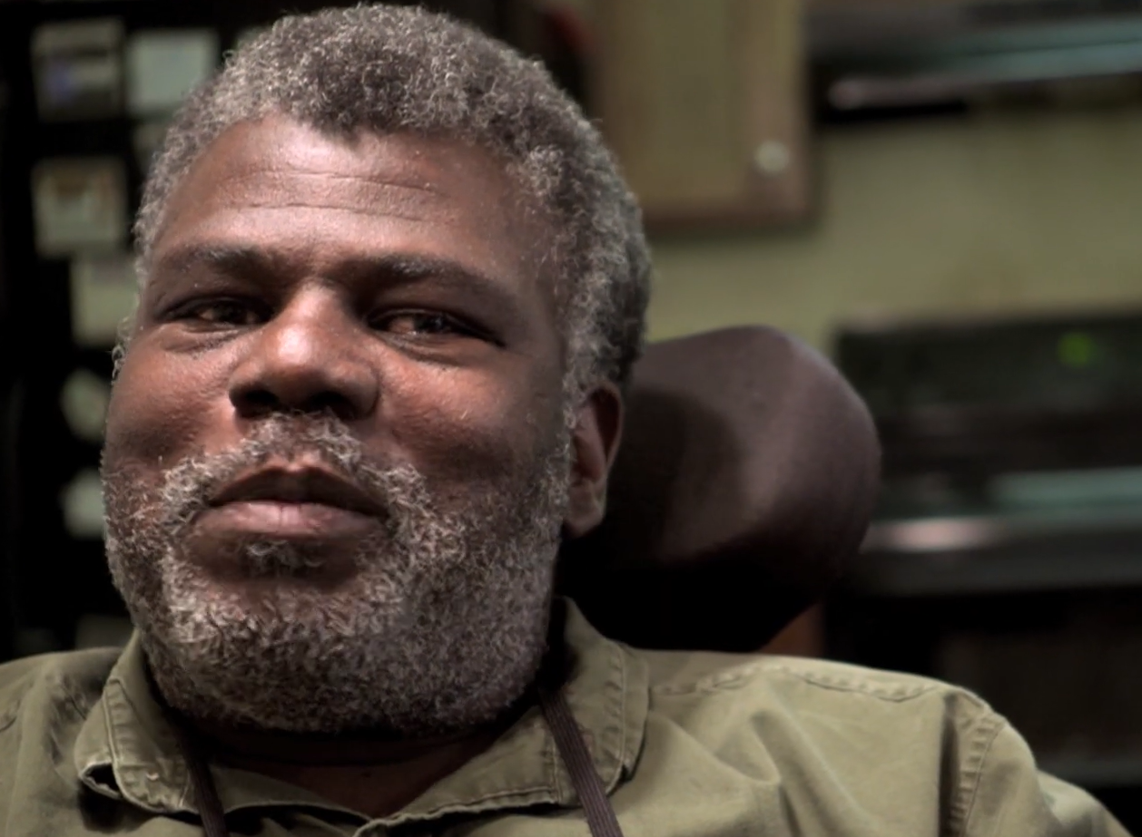
Video Discussion
What assistance did Bernard use?
What does Bernard do to remain independent?

Slide 19
Communication Considerations

Slide 20
Differences and Disorders
Communication Difference: a way to communicate that is different from verbal speech and hearing.
Communication Disorder: an illness or condition that impacts a person’s ability to communicate, which may or may not respond to treatment, or progress over time.
(American Speech-Language-Hearing Association, 1993)

Slide 21
Hearing Loss and Deafness
Hearing Loss: a partial or total inability to hear sounds, caused by genetics, aging, illnesses, accident or injury, or exposure to loud noises
Deafness: having little to no hearing, under the umbrella of hearing loss.
A cultural note: Some people identify as Deaf, or as part of the Deaf community. Others prefer deaf or hard of hearing.

Slide 22
Interpreters
When an ASL interpreter is involved:
  Prepare the interpreter ahead of time
  Do not use family or collaterals to interpret
  Speak to the person, not the interpreter
  Position the interpreter beside you when possible
When a CDI (Certified Deaf Interpreter) is involved:
  The CDI does not replace the ASL interpreter
(Registry for Interpreters for the Deaf, 1997)

Slide 23
Augmentative and Alternative Communication
Augmentative communication devices supplement existing speech.
Alternative communication devices are used when speech is not present or functional.
When someone uses AAC:
  Learn about the device or method
  Tailor your questions to their experience level
  Slow down, allow for silence
  Do not touch any accessibility tool without that person’s permission
(American Speech-Language-Hearing Association, n.d.)

Slide 24
Aphasia and Apraxia
Aphasia
Apraxia
Causes: strokes, TBI, tumors, progressive neurological disease
Behaviors may include:
Be unable to say what they want to
May understand the speech or writing of others, or may be unable to understand others
Repeat the same words or phrases over and over
Be aware of their own difficulties
Causes: strokes, TBI, tumors, neurocognitive disorders, or genetics
Behaviors may include:
Make up words or say something other than what they mean
Talk slowly or haltingly
Find it easier to use simple words and phrases
Say something once, then not be able to say it again
Be unable to make sounds or words at all
(National Institute on Deafness and Other Communication Disorders, 2025; 2017)

Slide 25
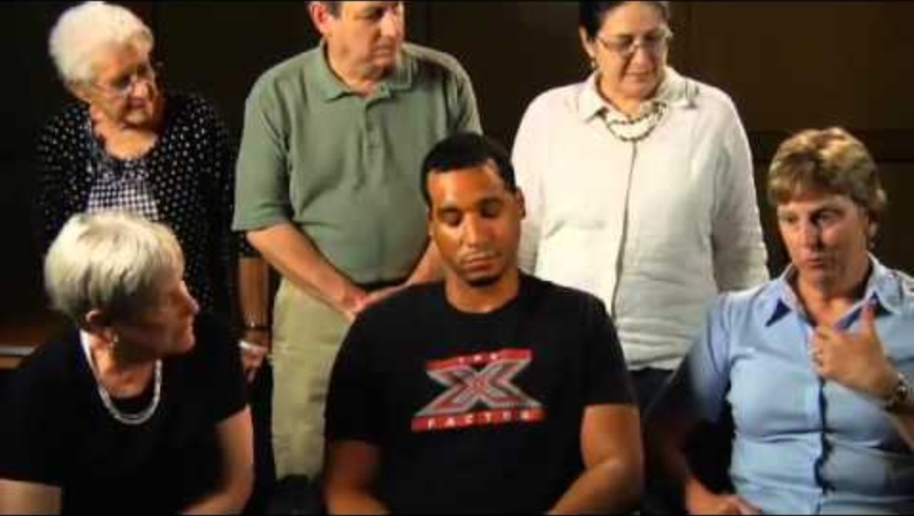
Aphasia Video
Patience, Listening, and Communicating with Aphasia Patients

Slide 26
Communication Best Practices

Slide 27
Interview Activity
Interviewer
Interviewee
Ask questions to learn ONE of the following facts about the interviewee:
Their coffee order
Their favorite movie
Their current job role and when they started it (month and year)
Answer ONLY in one of the following ways:
Say “Yes” or “No”
Physical gestures that communicate yes and no (nodding/shaking the head, thumbs up or down, another gesture you choose)
Each interview concludes after three minutes.

Slide 28
Report Back
  Interviewers: Did you get an accurate answer? What strategies worked?
  Interviewees and Referees: What was your experience? Was there something you wished the interviewer had done?
  Should there be any changes to the Communication Best Practices list?

Slide 29
Risk Considerations

Slide 30
Risk Factors
  Assistive devices for mobility or communication
  Caregivers
  Transportation services
  Isolation
  Communication differences
(Badakhshiyan, et al., 2024; Office for Victims of Crime, 2012)

Slide 31
Strength-Based Service Planning

Slide 32
Strength-Based, Person-Directed
Strength-Based: focused on leveraging strengths, not compensating for deficits
Person-Directed: places the individual at the center of all decisions about their lives
  Support fully informed decisions
  Preserve autonomy
  Allow for change over time
(APS TARC, 2024)

Slide 33
Considerations: Safety
Service Plans are individualized. When someone lives with a physical disability, include disability-specific considerations.
Ask: How does the person reach out for help?
  How do they communicate when they are in an unsafe situation?
  Who are their trusted people?
  Where can they go when they feel unsafe?
  How do they say “no”?

Slide 34
Considerations for Service Planning
What are other service planning considerations for individuals with physical disabilities?

Slide 35
Least-Restrictive Alternatives
The principle of the Least-Restrictive Alternative states that any intervention, treatment, or action should impose the minimum necessary restrictions on a person’s rights or freedoms.
  Protect individual rights and autonomy
  Tailor each intervention to the specific person’s needs
  Minimize social and physical isolation
  Avoid unnecessary restrictions or institutionalization
  Preserve the right to make as many decisions as possible

Slide 36
Resources and Services
APS cannot determine eligibility, but can assist with applications
  What community programs or local services are available?
  Are there state initiatives or programs?

Slide 37
Scenario Activity
In groups, review your scenario and discuss:
  What are the concerns and strengths in this scenario?
  What are communication best practices that apply?
  What are the accessible service planning considerations?
  Any other thoughts?

Slide 38
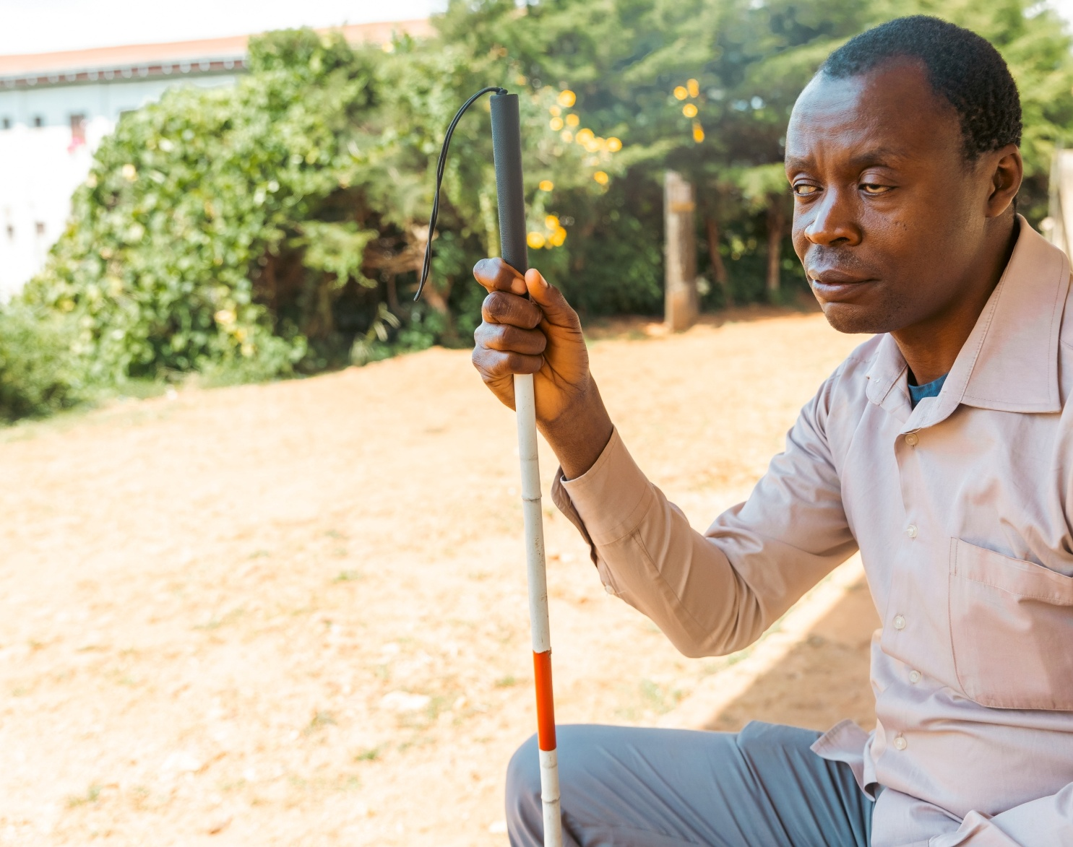
Case Scenario 1: Alan
72, was born blind
Uses a cane and can read braille
Wife Bonnie, 70, has late-stage Parkinson’s disease
HHA cleans, organizes, removes sticky dots on appliances
Alan has avoided taking medications and sometimes doesn’t eat
Doesn’t want to complain because the HHA helps his wife
Alan is very thin and shaky, but “Fine. Bonnie’s got it worse.”

Slide 39

Case Scenario 2: Carmela
91, lives with severe arthritis
Her grandson and his wife are her caregivers, but each has a job and they have a young son.
Carmela needs assistance due to severely limited mobility, uses a wheelchair
Carmela mostly watches TV or listens to the radio
Carmela cries at bible study
Her friends and pastor are concerned
Friend noticed hand-shaped bruises on her upper arms
Carmela says, “I…fall.”

Slide 40
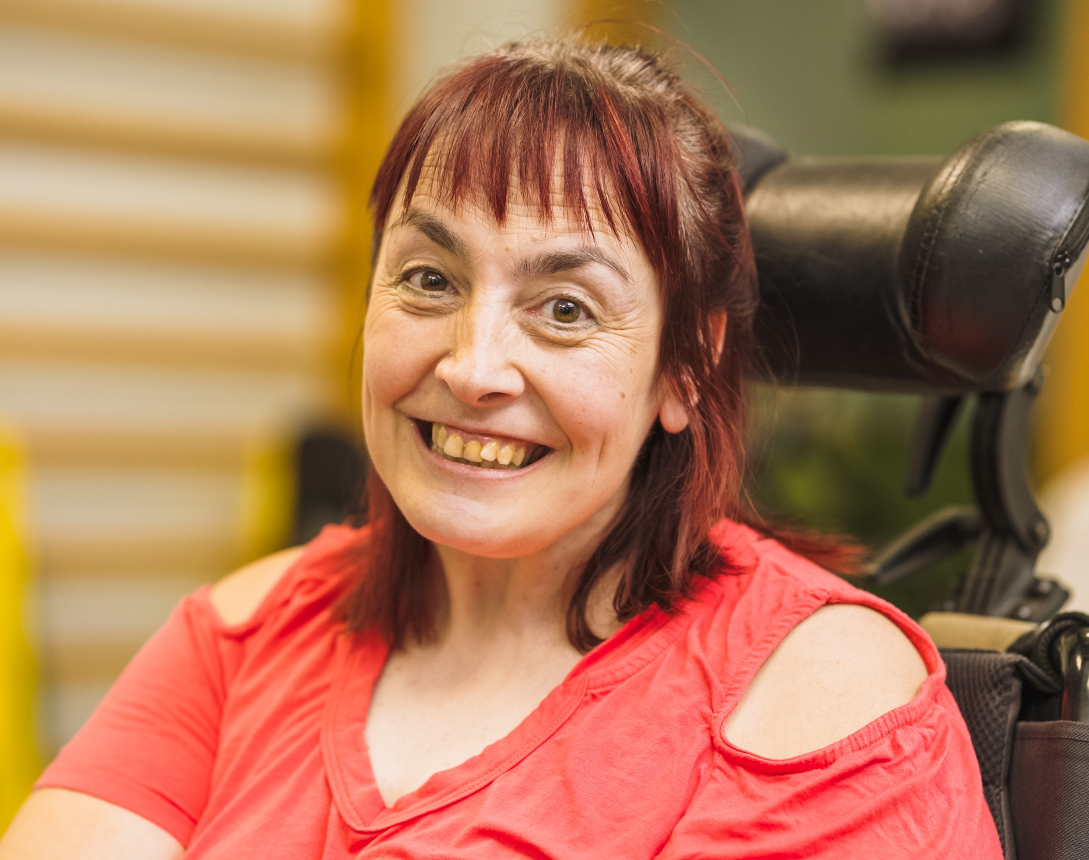
Case Scenario 3: Ferdie
48, lives with advanced MS
Electric wheelchair for mobility, largely independent with assistive supports
Speech is slow and difficult to understand, uses a joystick device to type
Ferdie has been missing doctor’s appointments because her friend moved, so she has no transportation
Living off of food delivery and not attempting to leave her apartment
Socializes online, where she can communicate as fast as everyone else
“I don’t see why I need to go outside anymore at all.”

Slide 41
Key Points
  Many individuals, and even more over 65, live with some kind of disability.
  If someone lives with a physical disability, that does not mean they also have an intellectual disability.
  Some communication difficulties commonly occur in people with physical disabilities, or are more likely to occur as people age.
  Adults with physical disabilities are at disproportionate risk for abuse and neglect.
  When interviewing an adult with a physical disability, build in more time, patience, and flexibility.
  When an interpreter or assistive communication device is involved during a conversation, always speak directly to the individual being interviewed.
  Service planning should focus on strengths, not deficits.

Slide 42

P-I-E Wrap-Up
  P – Priceless piece of information.
  What has been the most important piece of information to you today?
  I – Item to implement.
  What is something you intend to implement from our time today?
  E – Encouragement I received.
  What is something you were already doing that you are encouraged to keep doing?

Slide 43
Thank You
Questions?

