Slide 1
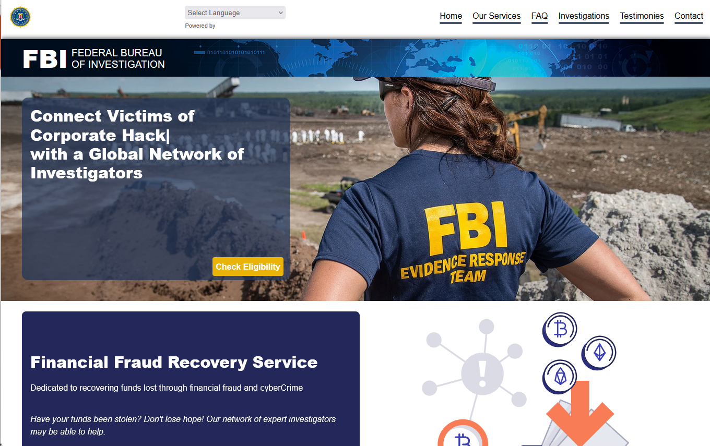
How did we get here?
Derek Smythe
Notes:
Screenshot: Scam website https://www.claimsinvestigationunit.com/, part of a FaaS host’s portfolio.

Slide 2



What is required to host a website?
Domain name
Name Server
Hosting
mywebsite.com
mywebsite.com is IP address 10.50.120.240
10.50.120.240 is here
Domain reseller / affiliate
Hosting provider (reseller of reseller)
Domain reseller / affiliate
Hosting provider (reseller)
Registrar Godaddy Namesilo OVH
Hosting provider
http://mywebsite.com
Data Centre
Registry .com .org .net …
Server IP address 10.50.120.240
Network Owner
Notes:
A simplified view of what is required to host a website.
To host a website, we need:
a domain name … mywebsite.com
a hosting provider which will sell us a hosting account with an IP address
a name server that links the domain name to the IP address
The domain name is purchased via a registrar or one of their agents, called a domain reseller. Each registrar has access to domain names controlled via numerous registries; .com, .org .net .shop ...
A hosting provider sells hosting accounts, giving customers space to publish websites that can be accessed via a specific IP address. There are several business models in this space, but the basic underlying infrastructure typically involves three key elements:
The hosting account seller – This is the company or agent offering hosting services to end users. In some cases, they may act as a reseller for another provider.
The network owner – The entity that owns and operates the network through which the hosting accounts are made accessible.
The data centre operator – The facility where the physical servers are housed, maintained, and secured.
These may all be the same party, or different companies.
A name server is required that will redirect users from a domain name to an actual IP address.
The end user device will query each of these entities in turn to render a web page.

Slide 3
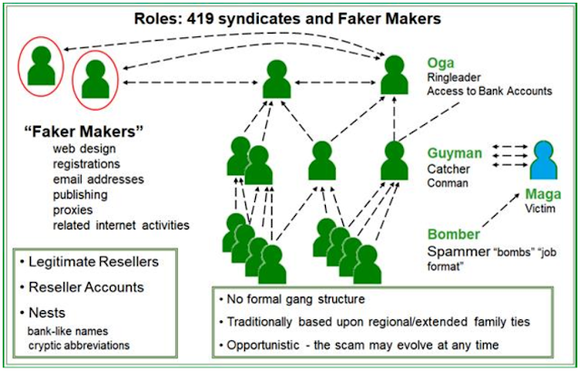
How it started
2007 to 2017
Notes:
https://blog.aa419.org/2017/12/19/the-faker-maker/
https://securityboulevard.com/2019/03/dissect-cyber-wins-major-dhs-st-award-for-their-bec-work/

Slide 4
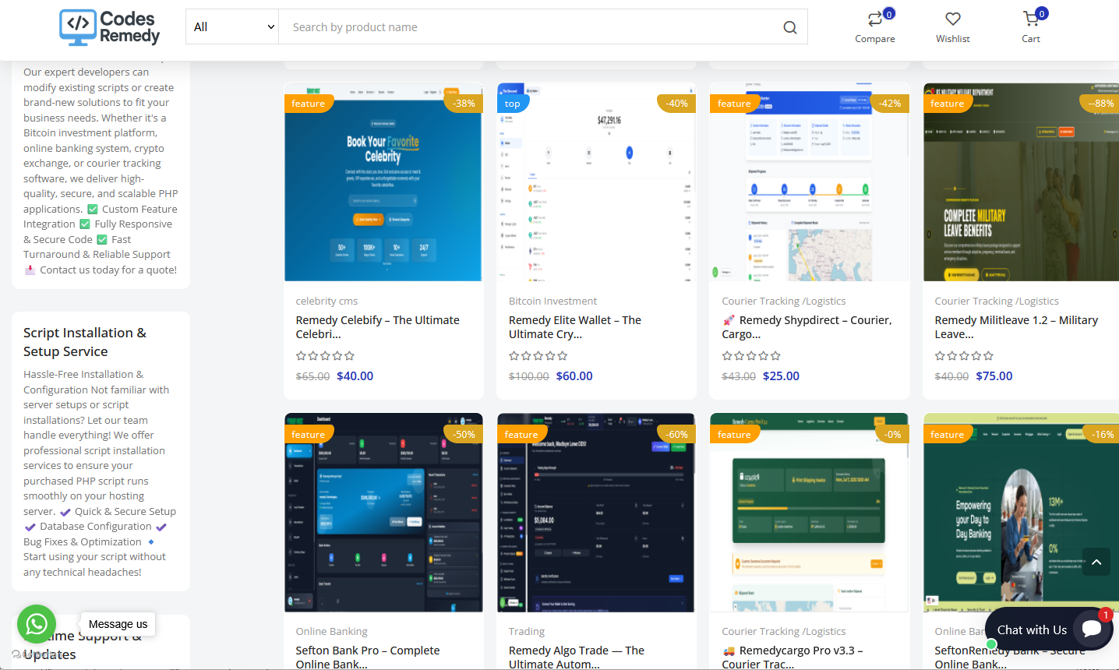
How it’s going
2025: Fraud-as-a-Service
Notes:
https://www.codesremedy.net/

Slide 5
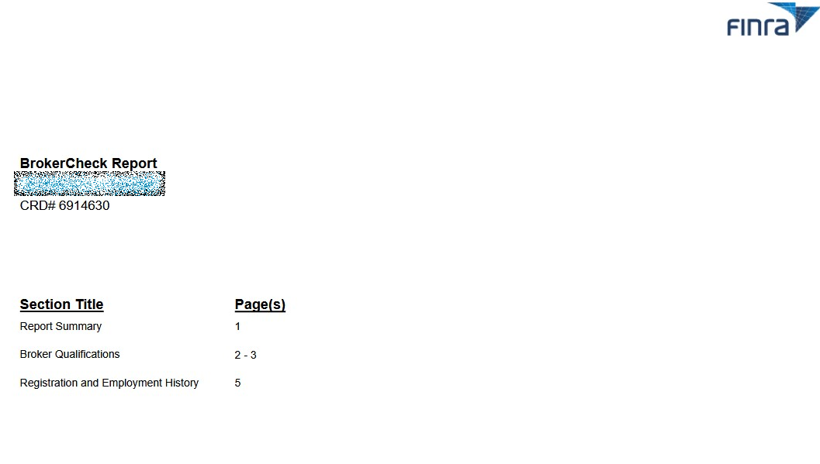
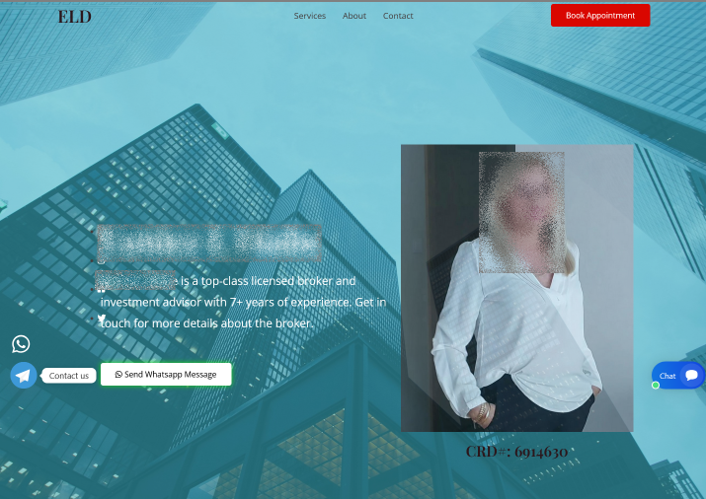
How it’s going
Scam website
Notes:
Impersonating: https://files.brokercheck.finra.org/individual/individual_6914630.pdf

Slide 6
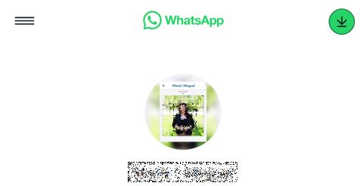
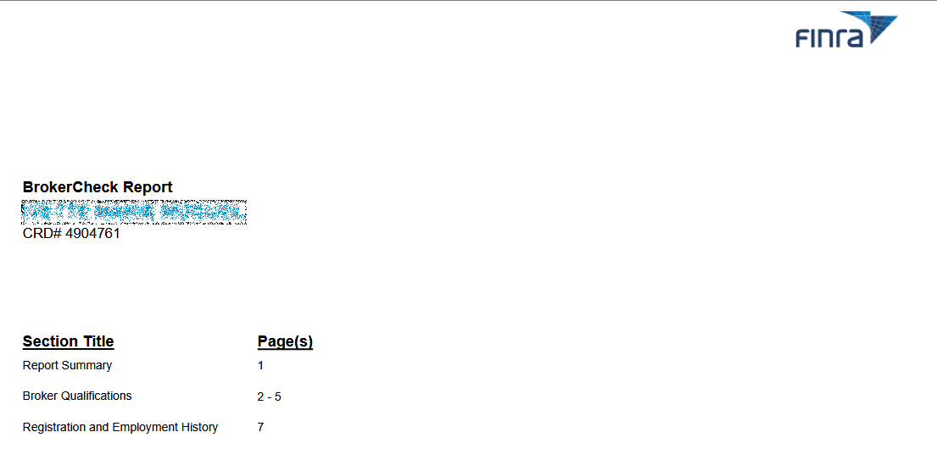
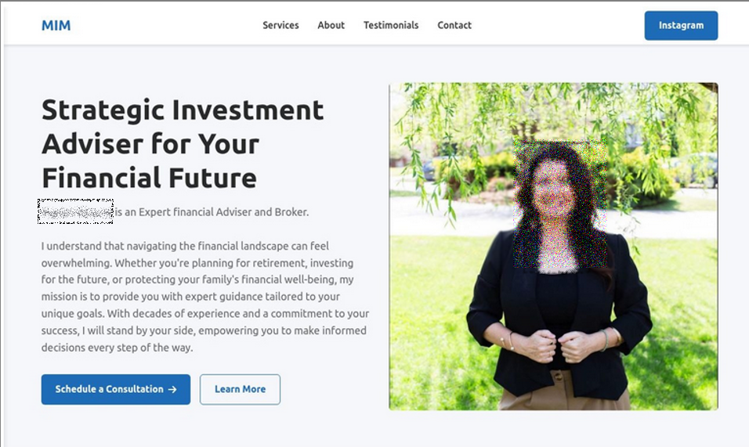
How it’s going
Scam Website
Notes:
https://files.brokercheck.finra.org/individual/individual_4904761.pdf
https://api.whatsapp.com/send/?phone=12522037155&text=Hello&type=phone_number&app_absent=0

Slide 7
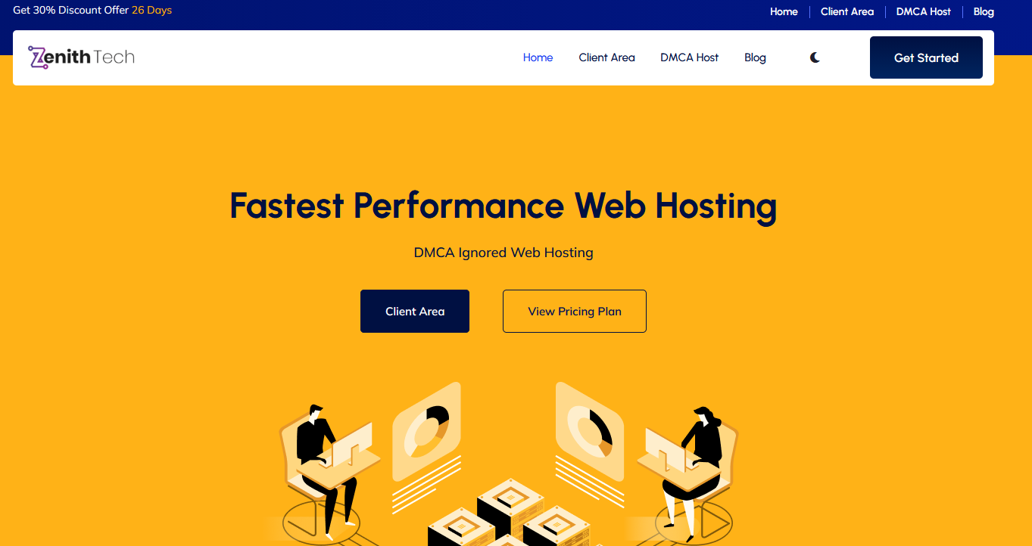

How it’s going
2025: Fraud-as-a-Service
Notes:
https://www.facebook.com/photo/?fbid=909990201149573&set=pb.100064158035254.-2207520000
https://zenithtechhosting.org/

Slide 8
How it’s going
Zenith Tech Scam-Type Breakdown
Scam Type | Qty
Fake Bank | 47
Courier | 9
Government | 3 | 2 x Military Romance, 1 x Job
Job | 1
Lawyer | 2
Investment | 91 | Includes 34 brokers impersonated
Grant | 1
Non-delivery | 1 | Romance scam linked
Rental | 1
Other | 6 | 5 x Recovery, 1 x Bitcoin phishing
Legitimate | 0
162 domains were analyzed
162 were used for scam websites
Zero were legitimate
Notes:
https://db.aa419.org/fakebankslist.php?cmd=ADV&x_Project=naijazenith
https://dns.coffee/nameservers/ns1.zenithtechhosting.org
https://interisle.substack.com/p/fraud-as-a-service-part-3-finra-broker

Slide 9
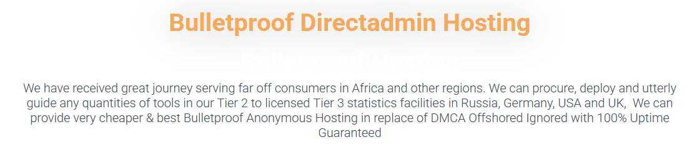
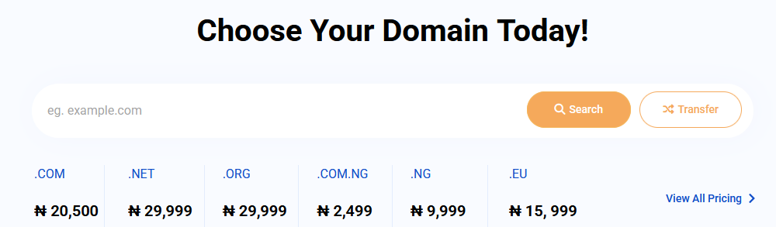
How it’s going
AbollyHost
Scam Type | Qty | Notes
Fake Bank | 126
Couriers / Logistics | 100
Military & Romance | 1
Job | 4
Investment | 58 | Includes 12 broker impersonation
Non-delivery | 17 | Fake procurement
Realty | 1
Phishing and hacking | 12 | Wallet phishing, wallet flashing, carding
Email servers | 4 | Used for email addresses for scams

Slide 10
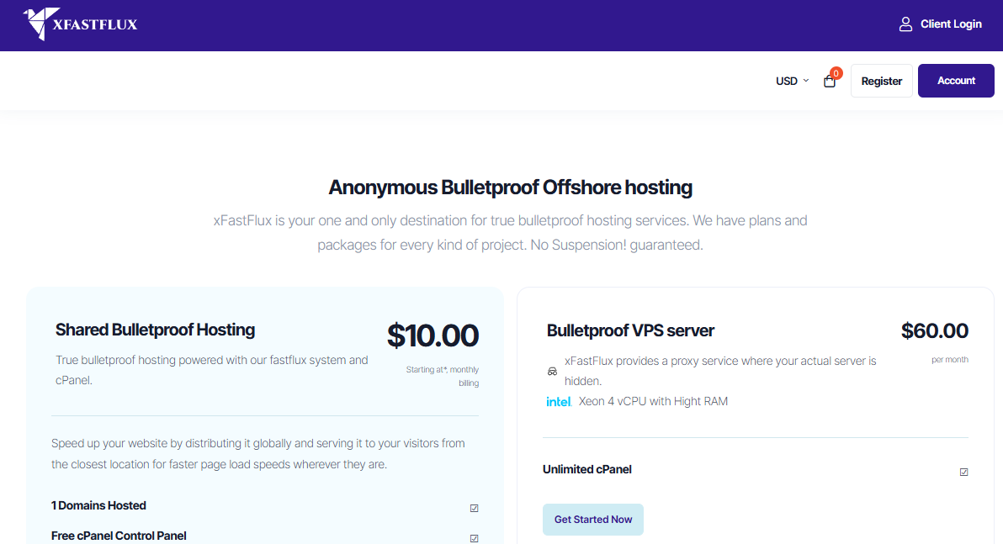
How it’s going
xFastFlux
Scam Type | Qty
Fake Bank | 65
courier | 76
Government | 2
Job | 2
Lawyer | 3
Investment | 49
Charity | 2
Non-delivery | 1
Other | 7 | 6 x Phishing, 1 x SGS spoof
Vehicle | 1

Slide 11
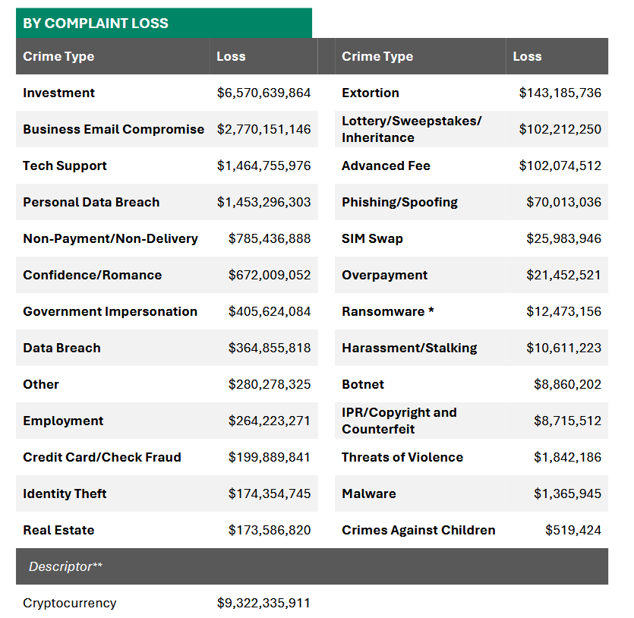
How did we get here?
Notes:
Source: https://www.ic3.gov/AnnualReport/Reports/2024_IC3Report.pdf

Slide 12
What is required to host a website?
Domain name
Name Server
Hosting
mywebsite.com
mywebsite.com is IP address 10.50.120.240
10.50.120.240 is here
Domain reseller / affiliate
Hosting provider (reseller of reseller)
Domain reseller / affiliate
Hosting provider (reseller)
Registrar Godaddy Namesilo OVH
Hosting provider
http://mywebsite.com
Data Centre
Registry .com .org .net …
Server IP address 10.50.120.240
Network Owner
Notes:
A website goes offline if either the domain name is suspended, or
If the the hosting account is suspended.
Moving to a new hosting account can be rapidly accomplished while the scammer or a FaaS provider has control of a domain. We’ve seen this happen with xFastFlux and other like hosts. The domain can also be abused in other ways that may be difficult to detect while under nefarious control; email scam spamming, subdomains on different hosts …
Since this is not a hacked website, rather a domain registered with the specific purpose of committing fraud, ideally the domain should be suspended.

Slide 13
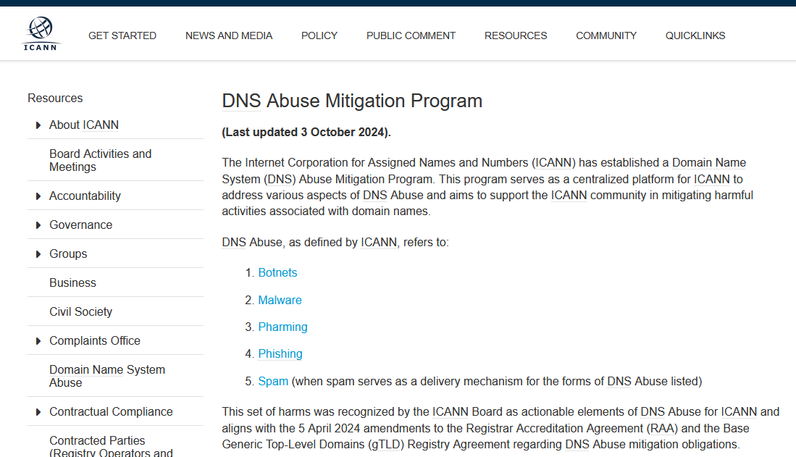
How did we get here?
Registrar acknowledged abuse.
A mismatch with IC3 statistics?
Notes:
https://www.icann.org/dnsabuse
https://www.verisign.com/news-insights/dns-abuse/

Slide 14
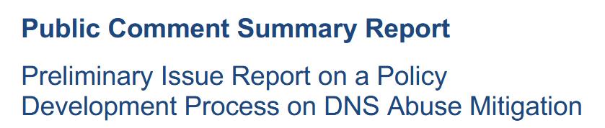
How did we get here?
Couldn’t we align ICANN definitions with IC3 losses where domains are weaponized?
CC.2 No Mechanism to Update DNS Abuse Definition:
Scoping: There is broad agreement amongst commenters such as Government
of India, NCSG, and Tucows for not expanding the current definition of DNS
Abuse currently; commenters endorse using the existing RAA-anchored
definition. The Government of India and NCSG agree that other definitions such
as the current ICANN definition “while malicious, are deemed outside of ICANN’s
remit as they pertain to content and therefore would violate ICANN’s bylaws.”
Proposed Solution by Commenter(s): The RrSG “is open to review where
attributes of DNS Abuse clearly and objectively have changed and evolved away
from the current definitions, while staying within ICANN's remit, and measuring
emerging vectors against those attributes.”
The BC, Fraudkillers, INTA, and IPC in contrast ask for a continuous update to
the DNS Abuse definition based on emerging and evolving threats. The BC and
INTA reference “that SAC115 recommends periodic review of abuse definitions,
as did the recommendations from the SSR2 team.” Fraudkillers want to see
“scams and fraud” included in the definition.
Notes:
https://itp.cdn.icann.org/en/files/generic-names-supporting-organization-council-gnso-council/pc-report-prelim-issue-report-pdp-dns-abuse-mitigation-17-11-2025-en.pdf

Slide 15
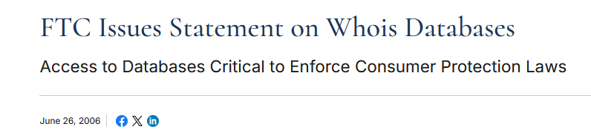
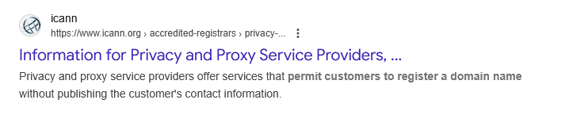
How did we get here?
Domain registration data moved from problematic to hidden
Domain registration data has always been a topic of contention, inaccurate.
Privacy and Proxy Services further hide domain Registrant details with no risk to self.
European GDPR adopted in Domain Registrations 2018 for all registrations.
Notes:
https://www.ftc.gov/news-events/news/press-releases/2006/06/ftc-issues-statement-whois-databases
https://www.icann.org/en/contracted-parties/accredited-registrars/privacy-and-proxy-service-providers
https://www.icann.org/resources/pages/icann-eu-gdpr-2022-12-22-en

Slide 16
How did we get here?
Abuse at Host level
Who is the host? The upstream hosting provider simply forwards the abuse report to his reseller. The reseller may be the problem, a FaaS provider.
If a hosting account is suspended, the domain owner can rapidly move it. One 419-domain “host-hopped” 27 times, each requiring a sperate mitigation.
Host-based mitigation can be detrimental to consumer safety for 419-domains. A 419-bank, a Bank of America spoof, had its hosting account suspended as phishing/content issues. The scammers simply changed the email server to capitalize on their existing scams, maintaining contact with and defrauding victims.
Bullet-proof hosts ignore abuse reports (offshore hosting)
Notes:
https://blog.aa419.org/phishing-sites-vs-fake-419-banks/
https://en.wikipedia.org/wiki/Bulletproof_hosting

Slide 17
Now we know how we got here!

