Slide 1


Building and Managing Effective APS Teams
By: Jessica E. Paradee Burke, MPA

Slide 2
Housekeeping for Virtual Platform
Video Camera
Mute/
Unmute
Chat Box
Emojis and Icons
If you need to step away
Potential technical glitches
Notes:
Hide this slide if presenting this training in-person.

Slide 3
Facilitator’s Name
Affiliation

Slide 4
Housekeeping for In-Person
Cell phones on silent or vibrate
Location of restrooms and emergency exits
Schedule
3-hour training
Materials:
Participant Manual
Action Plan
Notes:
Hide this slide if presenting this training virtually.

Slide 5
Learning Objectives
Explain the importance of teams & teambuilding in APS.
1
Explain how to build & manage healthy, effective teams.
2
Identify strengths & weakness within your team.
3
Explain benefits of using trauma-informed approach to managing teams.
4

Slide 6

Group
Discussion

Slide 7


Groups versus Teams
Shared Values
Complementary Roles
Feelings Expressed
Commitment
Consistency
Trust
Conflict Resolution
Listening
Cooperation
Diversity
Efficiency
Respect
Accountability
Relationships
Unified Purpose
GROUP
TEAM
WEAK
STRONG
(Leigh & Maynard, 2002)

Slide 8
Team Building-
The Basics
What is Team Building?
The process of bringing individual employees together as a unit; therefore creating a team.
Where do I even start?
Establish your role as a leader
Build trust
Foster individual relationships
Build rapport
Build relationships
Communicate clearly
Establish a vision
Set goals
Support and respect team members

Slide 9
The Importance of Teams and Teamwork in APS
Combined Knowledge: Individuals bring their own expertise and perspectives to the team.
Collective Resources: Individuals access to different resources and helping disciplines.
Shared Responsibility: Shared input from team members on complex client situations can be beneficial to all.
Support Network: Nobody knows the trials and joys of the job more that our teammates. Teams allow us to feel supported.

Slide 10
Building Team Strength and Resilience
Be
Transparent
Build
Trust
Keep
Your team informed
Provide
Expertise
Praise
Successes
Embrace
Challenges as opportunities to learn
Build
Relationships - With individual team members and the team as a whole
Remain
Supportive

Slide 11

Page 7: Journal Entry
Have I given my team members the support they have given me?

Slide 12
Team Member Buy-In:
Shared Qualities
Whereas we all are different and unique, we all share the same profession.
We all want to keep the vulnerable adult population free from maltreatment, neglect, and exploitation.
Each of us all has knowledge and skills that are unique and can be combined to collectively assist individuals, groups, and communities.
APS work is complex, and resources are limited; therefore, we can be more successful as a team versus working in a silo.

Slide 13
Team Meeting Facilitation
Facilitating Team Meetings
Facilitating the meeting as an MDT-case consultation
Encouraging relationship building within the team

Slide 14
Page 8: Journal Entry
How can I make my team meetings productive and inspiring?

Slide 15
Characteristics of Healthy Teams
Effective communication
Shared focus and goals
Diversity
Good leader
Organization
Equal contribution
High morale
Commitment
Clearly defined roles
Respect
Trust

Slide 16
Characteristics of Teams
Unhealthy
Fear
Cannot express themselves
Dysfunctional employee relationships
Unaddressed conflict
Avoidance of accountability
Toxicity
Absence of trust
Lack of recognition

Slide 17
Page 10: Journal Entry
What elements create a positive team experience? What elements create a negative team experience?

Slide 18
Characteristics of Well-Led Teams
Accepting attitude among team members
Inspiring purpose
Clear, challenging goals
Leader listens and communicates
Consistent appreciation and feedback
Acknowledgement of team feelings and concerns

Slide 19

Healthy Team Development
Supervisor’s Responsibility
  Developing a positive group culture
  Handling conflict between team members
  Managing the group within the larger work environment

Slide 20
Tuckman’s Stages of Group Development
Forming
Storming
Norming
Adjourning
Performing
The Academy for Professional Excellence. (2013). Teambuilding for APS Professionals. Trainer Manual (p.-50-56)

Slide 21
Page 12: Hand-Out
Tuckman’s Stages of Group Development

Slide 22
Team
Assessment
Activity

Slide 23
Page 14 – Team Assessment
Page 15 - My Action Plan

Slide 24
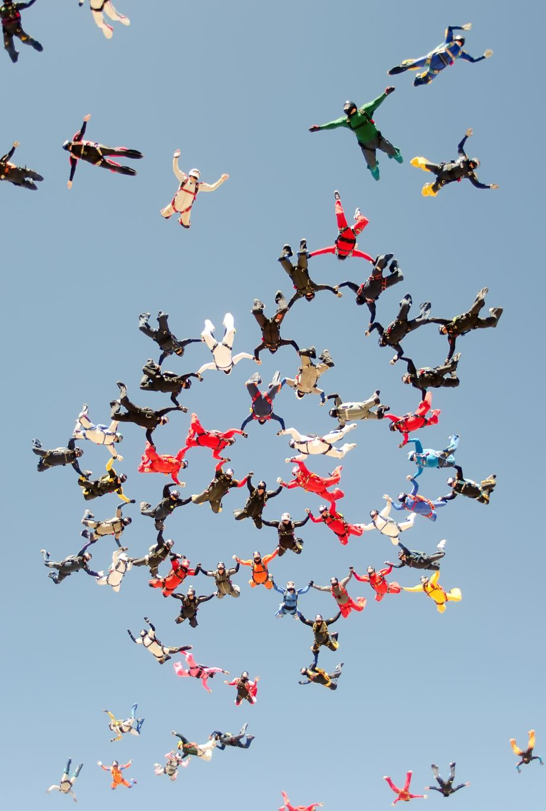
Teams: Taught or Modeled?
What are the values that your team leader instilled in you? How did that team leader inspire you?

Slide 25
Motivation: Individuals and the Team
One size does not fit all
Know what motivates each member of your team
Intrinsic versus Extrinsic
Intrinsic motivation: internal drive and psychological rewards.
Feels good helping others
Accomplishment
Extrinsic motivation: Reward driven behavior
Deadline
Promotion
Praise
Money
For Your Improvement (FYI)
Unskilled
Skilled
Overused Skill

Slide 26
Page 18: Hand-Out
For Your Improvement:
Motivating Others

Slide 27
Page 19: Journal Entry
When it comes to motivating others, what am I skilled at? Where could I improve?

Slide 28
Belbin’s Team Roles
Action Oriented Roles
Shaper
People Oriented roles
Coordinator
Thought Oriented Roles
Plant
Implementer
Completer-Finisher
Team worker
Resource Investigator
Monitor-Evaluator
Specialist

Slide 29
Page 21: Hand-Out
Belbin’s Team Roles

Slide 30

Challenging Team Members
An individual's behavior within the team setting is a function of the group dynamics.
Stereotypical Roles:
  Deviant Member
  Scapegoat
  Quiet Member
  Internal Leader

Slide 31

Challenging Team Members
In your small groups, make a list of challenges you have experiences with team members.
Choose one challenge to focus on and identify a few options for responding effectively.
Small groups will have 15 minutes for their discussion.
Reconvene and share ideas with full group.
There is worksheet for keeping notes on Page 24 of your
Participant Guide.
Notes:
Cr

Slide 32

Trauma, Secondary Trauma, Compassion Fatigue
Trauma: a deeply distressing or disturbing experience.
Secondary Traumatic Stress: is a lasting or even recurring emotional anguish that results when an individual learns about the firsthand experiences of another person or animal’s traumatic experience.
Compassion Fatigue : can arguably be described as a stage of trying to cope with repeated exposure to trauma.

Slide 33

Trauma-Informed Approaches
Supervisors must assist workers in identifying when they have been exposed to trauma and be available to assist with debriefing it.
  Always ensure the well-being of the worker
  Appreciate silence
  Allow tears and venting
  Become familiar with Trauma-Informed Practice concepts, research and resources.

Slide 34
Page 26: Hand-Out
Trauma-Informed Approach
MentalHealth.org

Slide 35

Managing
Virtual Teams

Slide 36
Page 28: Link
Ice Breaker Handout
Handout-Brain-Breaks-and-Ice-Breakers-for-Virtual-Work-Final.pdf (napsa-now.org)

Slide 37

Transfer of Learning
To be done on your own time
Should take about 30 minutes

Slide 38
Page 30: Hand-Out
Transfer of Learning Worksheet
with Instructions.

Slide 39

Closing and Evaluations
Final Journal Activity
Evaluations
Thank you for your participation
“Successful leaders embrace the power of teamwork by tapping into the innate strengths each person brings to the table.”
–The Power of Teamwork Inspired by the Blue Angels
Notes:
Remind participants that team building requires ongoing attention, care, and evaluations.
Journal activity/Individual Reflection:
Have participants journal 2 things that really stood out to them today. If time permits, allow a few participants to share.
Ask if there are any questions regarding today’s session
Ensure that participants are clear on the TOL expectations.
Thank participants for taking time for their own professional development by attending this training and for what they do every day for their staff and the older and dependent adults in the community.
Allow time and provide information for evaluations.
Thank participants for attending the training.

