Slide 1
Supervisor as Trainer

Slide 2
Virtual Housekeeping
Using Technology Features
Video Camera
Mute/Unmute
Chat Box
Emoji and Icons
If you need to step away
Potential technical glitches

Slide 3
Supervisor as Trainer
Facilitator Name
Organization

Slide 4



Supervisor as Trainer
The Adult Protective Services Supervisor
A Multi-Faceted Role

Slide 5

Supervisor as Trainer
A Multi-Faceted Role
Case Supervision
Managing Personnel Issues
Community Representation
Back-Up Coverage to Staff
Ensuring Compliance
Role Modeling
Training (an essential part of supervision)

Slide 6
Supervisor as Trainer
Session Topics
Learning & The Adult Brain
Training Settings & Techniques
Phases of Learning
Transfer of Learning

Slide 7

Supervisor as Trainer
Section 1
Learning
&
The Adult Brain

Slide 8
Supervisor as Trainer
Principles Common to Adult Learners
We build new knowledge on what we already know.
Learning is a continuous process - always changing and adapting to new experiences/needs during our lifetime.
Learners have their own experiences, constraints and learning preferences.

Slide 9

Supervisor as Trainer
The Brain’s Ability To Grow and Adapt
Billions of brain cells called “neurons.”
Neurons connect to form networks/pathways.
Can strengthen existing pathways and form new ones. (“plasticity”)
As long as the brain is stimulated, it can keep growing and adapting.

Slide 10

Supervisor as Trainer
How Adults Learn

Slide 11

Supervisor as Trainer

Slide 12
Supervisor as Trainer
Adult Learning Principles
Seeing the relevance (How and why will this help me?)
Taking ownership and making choices
Building on prior knowledge and experiences
Accepting the need to grow and change
Utilizing problem-solving approaches
Wanting to be successful learners
And benefitting from repetition and practice!

Slide 13

Supervisor as Trainer
Repetition and Practice
When training content is new to the learner, there may not be prior knowledge or experience to connect with in the brain. The initial learning is
often superficial and may not be retained very long.
Frequent repetition and practice allow learners to build connections and reinforce new brain pathways. Training content gradually becomes more meaningful and permanent.

Slide 14

Supervisor as Trainer
What Do You Think Could Be Barriers To Adult Learning?

Slide 15
Supervisor as Trainer
Common Barriers
Fear
Confusion
Anxiety
Fear of making mistakes
Not understanding the relevance
Resistance to change
Not enough training time allotted
Overly-formal atmosphere
Others?

Slide 16

Supervisor as Trainer
Supervisors can apply adult learning principles during their case consultations and staff meetings.
Promote supportive environment and climate of risk-taking.
Define relevance clearly.
Repeat key points several times.
Let trainees “teach back.”
Provide constructive feedback.
Ensure frequent opportunities for review and practice

Slide 17

Supervisor as Trainer
Page ___ Links to Articles:
Implementing the A.G.E.S. Model for Effective Training Delivery
Brain-Based Learning: Multiple Intelligences
Howard Gardner’s Theory of Multiple Intelligences
Page ___ :
Examples of Multi-Sensory Training Activities

Slide 18
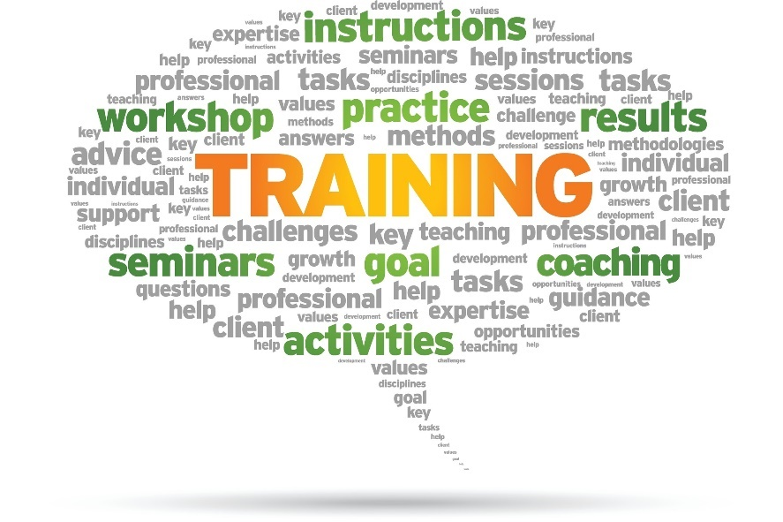
Supervisor as Trainer
Section 2
Training Settings
&
Techniques

Slide 19





Supervisor as Trainer
Training Settings

Slide 20
Supervisor as Trainer
Formal Settings
Instructor-led
Structured and focused on specific topic
Usually time-limited
Diverse participant pool
Presented by someone other than yourself
Delivered in-person, virtually or by e-learning

Slide 21
Supervisor as Trainer
Individual and Small Group Settings
Individual
One-on-one time with supervisor
Structured observations with staff
On-the-job practice
Small Group
Good environment for learning together, practicing skills, and teaching one another
Can be scheduled as a staff training or part of a staff meeting
Engage staff in selecting topics and peer presenters and in preparing training materials
Usually Result of Mistake/Misunderstanding
Understand the Issues Involved
Guide Problem-Solving & Corrective Steps
Unpredictable and Good Opportunities for Training

Slide 22
Supervisor as Trainer
“Teachable Moments”
Can be individual or group
Evolve from mistakes or successes
Good opportunities for learning, reflection and
problem-solving.

Slide 23
Supervisor as Trainer
Workshops /Conference Settings
Usually off-site and outside the group
Supervisor considerations
- how long will trainee be away from office?
- Am I familiar with the trainer?
- Is the content standardized?
Post-training assessment of understanding of content, accuracy of materials, new changes
Opportunity for attendees to share learning with team.

Slide 24
Supervisor as Trainer
Agency Settings
Usually mandatory for all employees
Sexual Harassment
Diversity
Rights & Responsibilities of Employees
Human Resources Content

Slide 25





Supervisor as Trainer
Training Techniques

Slide 26
Supervisor as Trainer
Please share one or two training techniques that you like to use with your staff – for example using case studies.

Slide 27
Supervisor as Trainer
Examples of Training Techniques
Lectures
Case Studies
Instructional Videos
Reading Assignments
Written Assignments
Brainstorming
Role Plays
Discussions
Structured Observation
Shadowing
Coaching

Slide 28
Supervisor as Trainer
Page
Characteristics and Benefits of a Variety of Learning Techniques
Page
Links to National Training Resources for APS Supervisors

Slide 29
Supervisor as Trainer
Training Resources for APS Supervisors . . .
APS Technical Assistance Resource Center
https://apstarc.acl.gov/Education/toolkits.aspx
APSWI Adult Protective Services Workforce Innovations
https://theacademy.sdsu.edu/programs/apswi/
Your State-Specific Resources

Slide 30

Supervisor as Trainer
Group Activity: Design a Training
Refer to the activity worksheet on Page ____ of your Participant
Guide for instructions
In your small group, discuss possible settings and techniques to accomplish your group’s assigned task.
Then visit one or both national training sites listed on the worksheet to find relevant resources to assist you.
Report your suggestions and findings to the full group.

Slide 31
Supervisor as Trainer
Section 3
Phases of Learning
New
Experienced
How did you feel at your first driving lesson?
What did you need?

Slide 32
Supervisor as Trainer
Phases of Learning
New
Experienced
If you had to take a driver refresher course,
what would you need now?

Slide 33
Phases of Learning
Supervisor as Trainer
1.
Unconscious Incompetent
3.
Conscious Competent
* Supervisor’s role may gradually shift to “coach.”
2.
Conscious Incompetent
4.
Unconscious Competent
We move from one stage to the next when learning anything new.

Slide 34
Supervisor as Trainer
Page
Phases of learning with suggested
with suggested training activities for
each stage.

Slide 35

Supervisor as Trainer
Supervisors Can Promote a Mindset of “Growth”

Slide 36
Supervisor as Trainer
Section 4
Transfer of Learning
(And Tips for New Supervisors)

Slide 37
Supervisor as Trainer
Please share one or two indicators you use to assess whether or not a training has been effective.

Slide 38
Supervisor as Trainer
Ways to Evaluate Effectiveness of Training
Assess staff member’s application of training content to real life cases
    Case review
    Interviewing and assessment skills
    Creation of service plans
    Accurate and complete documentation
Assess client outcomes
Is the client safer?
Respect for client self-autonomy?
Are services in compliance?
Staff self-evaluations
Have staff do self-assessments

Slide 39

Supervisor as Trainer
When Learning Hits a Roadblock

Slide 40
Supervisor as Trainer
Factors to Consider When Dealing with Staff Roadblocks
Is this a single instance or a pattern of behavior over time?
How is this affecting you and the team?
Are you avoiding accountability issues with your staff?
  What issues is the staff member avoiding?
  What are the consequences to the team?
What is the staff member’s perspective? What are they needing?

Slide 41

Supervisor as Trainer
In your small group, share with each other your experience with staff members who seem “stuck” and how you have responded.
Next, choose one of the examples to discuss in more depth and to identify a few strategies for responding effectively.
Report your suggestions to the full group.

Slide 42
Supervisor as Trainer
Sample Transfer of Learning Tool
Page 53

Slide 43

Supervisor as Trainer
Responding to Roadblocks
Be clear about your observations and expectations.
Talk to your staff member to get their perspective. What do they need?
Develop a plan together to address gaps, additional training, and needs for
supervisory support.
Most adult learners want to be successful and enjoy the learning process.

Slide 44

Supervisor as Trainer
For New Supervisors

Slide 45
Supervisor as Trainer
Tips for New Supervisors
Take time to understand the team dynamics
Practice saying “Thank you for letting me know how things have been done in the past.”
Be open-minded as you assess what is needed and how you will respond.
Evaluate your own style and methods as needed.
Use training resources designed for you.

Slide 46
Supervisor as Trainer
A Transfer of Learning Follow-Up Assignment for You
Develop a training activity to meet a specific training need that you describe.
Describe the types of settings and techniques you will use and why you chose them.
Include any additional training resources you plan to use.
Describe how you will evaluate the effectiveness of your training activity.
Share your training activity with other supervisors at your next meeting.

Slide 47
Supervisor as Trainer
Transfer of Learning Exercise
Page

Slide 48
Supervisor as Trainer
Thank You for Participating!

