Slide 1
Boost Session Supervisor as Coach

Slide 2
Housekeeping for Virtual Platform
Video Camera
Mute/
Unmute
Chat Box
Emojis and Icons
If you need to step away
Potential technical glitches
DAAS - Division of Aging and Adult Services
Notes:
Hide this slide if presenting this training in-person.
Producer:
Before we get started, let’s review some virtual housekeeping details to be sure we’re familiar with the technology features we’ll be using to communicate with each other.
Some of you may be more familiar than others navigating through a virtual learning course. So, we will briefly review the various functions of the virtual environment:
Video Camera: Find the camera icon; when you do, please turn the camera off and on. During the session, please keep the video camera on since this is an interactive course.
Mute/Unmute: Now, please locate the microphone. When you do, practice muting and unmuting yourself.
Chat box: Find the chat icon. We will be using the chat function to communicate throughout the session.
Emoji and Icons: These differ within the different virtual platforms
While participants are expected to attend the entire training, if you need to step away, please let the facilitator know by private chat.
And just a word about technical glitches. They are inevitable - on our end and your end! So please be patient and forgiving as we all navigate this virtual platform together.

Slide 3
Welcome Back! Coaching and Mentoring for APS Supervisors Boost Training
Facilitator Name
Organization
DAAS - Division of Aging and Adult Services
Notes:
Facilitator: Welcome Back Everyone. So glad to be here to facilitate part 2 of this module on Coaching and Mentoring for APS Supervisors.

Slide 4
The Purpose of Today’s Boost
Review of Transfer of Learning Activities
Participate in 2 group exercises to debrief activities
Discuss a Plan of Action and Transfer of Learning Activities for sustainment
DAAS - Division of Aging and Adult Services
Notes:
Facilitator: The Purpose of Today’s Boost training is to:
Review of TOLs Activities
Participate in 2 group exercises to debrief activities
Discuss a Plan of Action and Transfer of Learning Activity for sustainment

Slide 5
Coaching and Mentoring for APS Supervisors Transfer of Learning
Goal # 1 - Develop and implement an Action Plan of how you will leverage your 2-3 Strengths as a Coach.
Goal # 2- Design and implement an Action Plan to improve 2-3 strengths you want to upgrade at the lower end of your Strengths Assessment.
Goal # 3- Using your Coaching Planner draft a coaching conversation for development or performance using the 5 E’s process and Ready – Set – Go! 5 Minute Coaching Questions from the Handouts Section of your Participant Guide on page 45.
Goal # 4- Meet with two of your staff and have a coaching conversation in the next two weeks.
Be prepared to debrief and provide feedback about the Strengths Action Plan and Coaching Conversation at the Boost Training.
DAAS - Division of Aging and Adult Services
Notes:
Facilitator:
Let’s begin by reviewing our transfer of Learning Activities
Goal # 1 - Was we asked you to develop and implement an Action Plan of how you will leverage your 2-3 Strengths as a Coach and this was based on the Strengths Assessment you took as part of your pre-work before the initial training. We will revisit that assessment in a minute.
Goal # 2- We asked you to design and implement an Action Plan to improve 2-3 strengths you want to upgrade at the lower end of your Strengths Assessment.
Goal # 3- Using your Coaching Conversation Planner draft a coaching conversation for development or performance using the 5 E’s process and Ready – Set – Go! 5 Minute Coaching Questions from the Handouts Section of your Participant Guide on page 45.
Goal # 4- Meet with two of your staff and have a coaching conversation in the next two weeks using the planner for development or performance.
Be prepared to debrief and provide feedback about the Strengths Action Plan and Coaching Conversation at the Boost Training which is what we are doing today.

Slide 6
Coaching & Mentoring for APS Supervisors
Complete a Coaching Self Assessment for Strengths Identification & Areas for Development
Notes:
Facilitator Says: As part of the pre-work prior to the first training you received we had you complete a Coaching Self Assessment form to identify your top 2-3 strengths and 2-3 strengths you want to upgrade

Slide 7
Notes:
Facilitator Says: This was the ASTD TeamSTEPPS Coaching Self-Assessment form you completed as part of the pre-work. As a result of taking the assessment you were able to identify your top 2-3 strengths in regards to coaching your staff, and 2-3 strengths you would like to improve.

Slide 8
Conversation starters…
Create an Action Plan
Strength | How can you leverage these strengths to coach staff
1.
2.
3.
Strength to Upgrade | What are your next steps? | What support do you need? | How will you monitor your progress?
1.
2.
3.
DAAS - Division of Aging and Adult Services
Notes:
Facilitator Says: Then we asked you in our last training to complete your Action plan that looked like this
You were asked to Look at the behaviors you identified as your strengths, prioritize, and list your top 2-3 strengths
Then you were asked how can you leverage these strengths to coach your staff?
You were also asked to look at the behaviors you indicated as lacking this skill, prioritize in the order you think are the most important to improve to better coach your staff, and list the 2-3 most important below.

Slide 9
Notes:
Facilitator: I shared with you, my example.

Slide 10
Debrief the 3 Post Training activities
In the 3 post Transfer of Learning Activities what did you discover about the process for yourself?
What strengths in your Strengths Action Plan did you identify to rely on and how did you use them or envision using them in coaching your staff?
How effective were you in developing the strengths you want to improve? What activities or strategies do you see yourself committing to improve them going forward? What are your next steps? What support do you need and how will you monitor your progress?
How effective were these activities for enhancing your skills?
DAAS - Division of Aging and Adult Services
Notes:
Facilitator: This first break-out activity will give you the opportunity to think about how you used your strengths to coach you staff and how you see yourself using your strengths for future conversations. Lastly you will discuss the strengths you want to upgrade and how effective you were in developing the strengths you want to improve? (15 min for small group activity)
In the 3 post Transfer of Learning Activities what did you discover about the process for yourself?
What strengths in your Strengths Action Plan did you identify to rely on and how did you use them or envision using them in coaching your staff?
How effective were you in developing the strengths you want to improve? What activities or strategies do you see yourself committing to improve them going forward? What are your next steps? What support do you need and how will you monitor your progress?
Overall, how effective were these activities for enhancing your skills?
Large Group Discussion- Facilitator Says: Welcome back everyone. May I ask for volunteers to unmute themselves to share with the large group? (15 min to debrief)

Slide 11
The 5 E’s for Elevating the Coaching Conversation
Engaging
Evoking
Exploring
Establishing
Evaluating
DAAS - Division of Aging and Adult Services
Notes:
Facilitator: During our last training we learned about the 5 E’s Coaching Conversation process and the tools that could be used with your staff to have a conversation about development or performance.
The 3 Coaching Tools Using a 5-Step Process were
The Coaching Conversation Process depicted on this slide
Coaching Conversation Process
Engaging- Engage staff to identify the purpose of the discussion. Identify the importance to the person, team, and organization.
Evoking- Evoke and share information about the situation. Gather information about the employee’s perspective, issues, and concerns.
Exploring- Seek and discuss ideas together. Explore needed resources and support. Involve other people. Turn ideas into action steps.
Establishing- Establish a plan of action. What the employee will do. What you will do to achieve success. Check for understanding. Agree on an evaluation process (i.e. we will conference together monthly to review and modify plan or Action Steps as needed).
Evaluating- Evaluate plan together to ensure that the employee and you have an understanding of the plan and what a successful outcome looks like. Discuss important features of the plan. Check for understanding. Convey confidence and commitment.

Slide 12
The 5 E’s Sample Statements & Questions Conversation for Development
Notes:
Facilitator: In the first training you were provided the 5 E’s sample statements and questions for a conversation about development

Slide 13
The 5 E’s Sample Statements & Questions Conversation for Performance
Notes:
Facilitator: In the first training you were also provided the 5 E’s sample statements and questions for a conversation about performance.

Slide 14
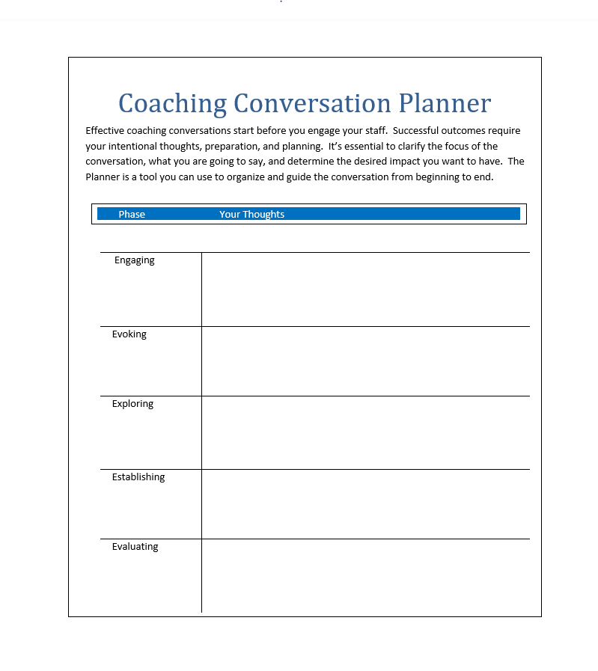
Notes:
Facilitator: You also received the conversation planner. This is a tool you were tasked with completing to have a conversation using the 5 E’s for development or performance with two of your staff over the course of the past few weeks, prior to attending the Boost training.

Slide 15
Small Group Activity
Coaching Conversation Reflection Activity
What did you discover about yourself as the supervisor guiding the coaching conversation?
What was your experience of engaging in a coaching conversation for performance? Was it difficult or relatively easy to do? How was the conversation for development?
What worked well?
What was challenging for you?
Is there anything you might want to incorporate or do differently next time when engaging in a conversation with staff?
What are your next steps?
Notes:
Facilitator: Now that we’ve revisted the 5 E process to facilitate Coaching Conversations, let’s focus our attention on discussing the coaching conversation and how that went for you doing this with two of your staff. You will discuss this in a small group. (15 min for small group activity)
In your small group I’d like you to respond to the following questions:
What did you discover about yourself guiding the coaching conversation?
What was your experience of engaging in a coaching conversation for performance? Was it difficult or relatively easy to do? How was the conversation for development?
What worked well?
What was challenging for you?
Is there anything you might want to incorporate or do differently next time when engaging in a conversation with staff?
What are your next steps?
Large Group Discussion- Facilitator: Welcome back everyone. May I ask for volunteers to unmute themselves to share with the large group? (15 min for debrief)

Slide 16
Coaching and Mentoring for APS Supervisors Transfer of Learning
Goal # 1 - Reach out to one of your peers this week to be your accountability partner for the next 30 days.
Goal # 2 - Touch base with your accountability partner a minimum of once a week to check on the application of your Strengths Action Plan and your conversations with staff.
Goal # 3 - Schedule a conversation with your supervisor in the next 30 days to discuss what you’ve learned, how this training has impacted you, and how you have applied it.
DAAS - Division of Aging and Adult Services
Notes:
Facilitator:
In closing today, we would like to evaluate whether this training has been effective. To do this, we are leaving you with a follow-up Transfer of Learning Activity to better help you implement the concepts learned, you debriefed about today, and apply what you’ve learned as follows:
Goal # 1 - Reach out to one of your peers this week to be your accountability partner for the next 30 days.
Goal # 2 - Touch base with your accountability partner a minimum of once a week to check on the application of your Strengths Action Plan and your coaching conversations with staff.
Goal # 3 - Schedule a conversation with your supervisor in the next 30 days to discuss what you’ve learned, how this training has impacted you, and how you have applied it.
Thank you for your participation today! You’ve been an amazing group. Let’s thank our Producer for keeping us on track.
With that, I will sign off and let you do evaluations. Take care
everyone and have a great rest of the week.

Slide 17
Closing and Evaluations Transfer of Learning Activity Evaluations Thank you for your participation!
DAAS - Division of Aging and Adult Services

