Slide 1
EXPLORING THE LEADERSHIP CHALLENGE
Michael Curtis
iLead Consulting

Slide 2
USING ZOOM
Place Your Interactive Slide Here with Instructions on How to Use Zoom
Raise Hands
Chat Box
UnMute
Anything Else

Slide 3
Notes:
Introduction Slide

Slide 4
THE LEADERSHIP CHALLENGE AND DFPS
Launched in 2016
Pilot Group Austin Texas
Astronomical Turn Over Rate
Six Months Later
Just Under 20 Staff Returned
11 Became Supervisors

Slide 5
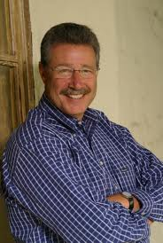
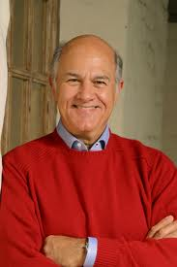
JIM AND BARRY
Jim Kouzes
Barry Posner
Notes:
Introduce Jim and Barry
Note: Jim (Koo-ZEZ) and Barry (POS-ner)
Jim and Barry are the authors of The Leadership Challenge and have been researching leadership for over 30 years.
Jim really cares about the language of leadership – he is a great story teller and encourages all leaders to do the same.
Barry is the statistician. While both Jim and Barry created the Leadership Practices Inventory, Barry is the one who does ongoing research – those great graphs in your 6th edition of The Leadership Challenge come from Barry’s research – obviously with Jim’s input.

Slide 6
POLL
Who Has Read The Leadership Challenge?

Slide 7
HOW DID IT ALL BEGIN
Your Leadership Best
What was the situation?
What did you do?
What was the outcome?

Slide 8
“
“Only three things HAPPEN NATURALLY IN ORGANIZATIONS: friction, confusion AND underperformance . . .
”

Slide 9
“
”
“. . . everything else
requires leadership.”
Peter Drucker
Notes:
When there is no-one setting the course, people will go in many directions. At best some staff will head in the right general direction. At worst, everyone heads in every directions.

Slide 10
What does a leader look like?

Slide 11
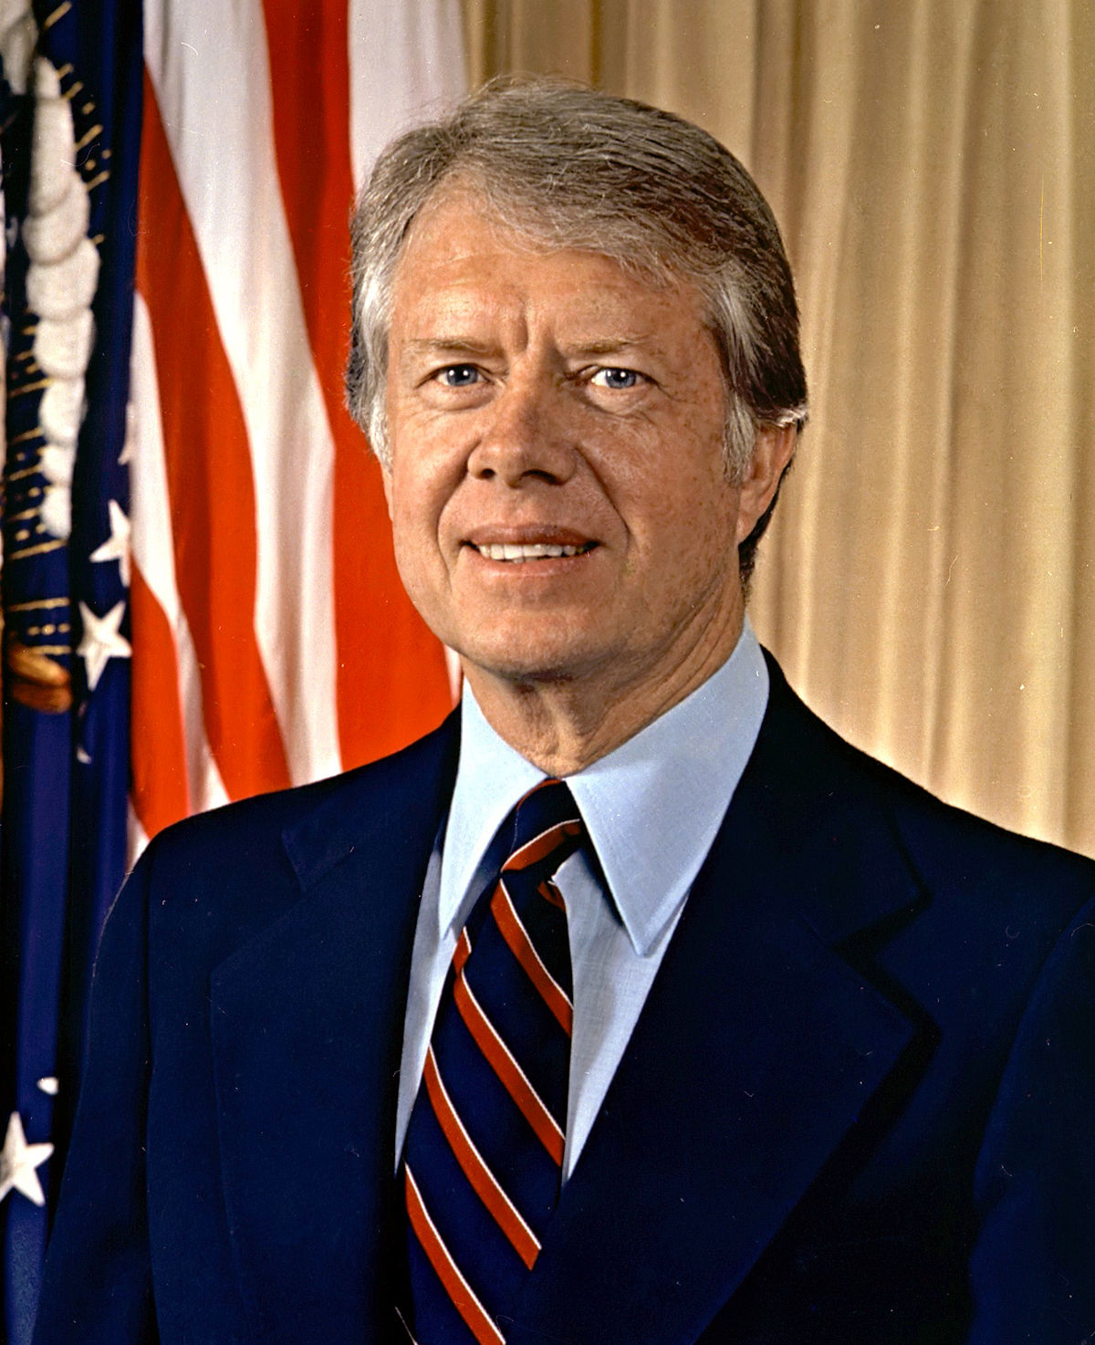
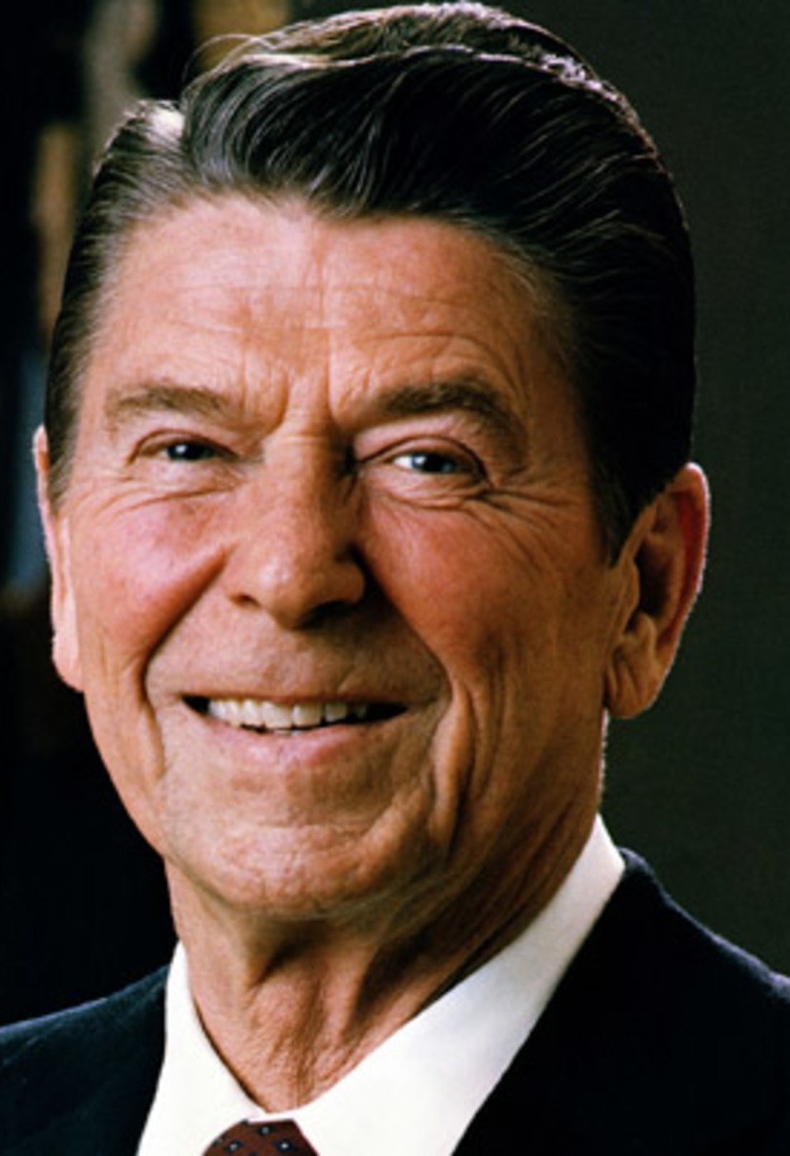

Slide 12
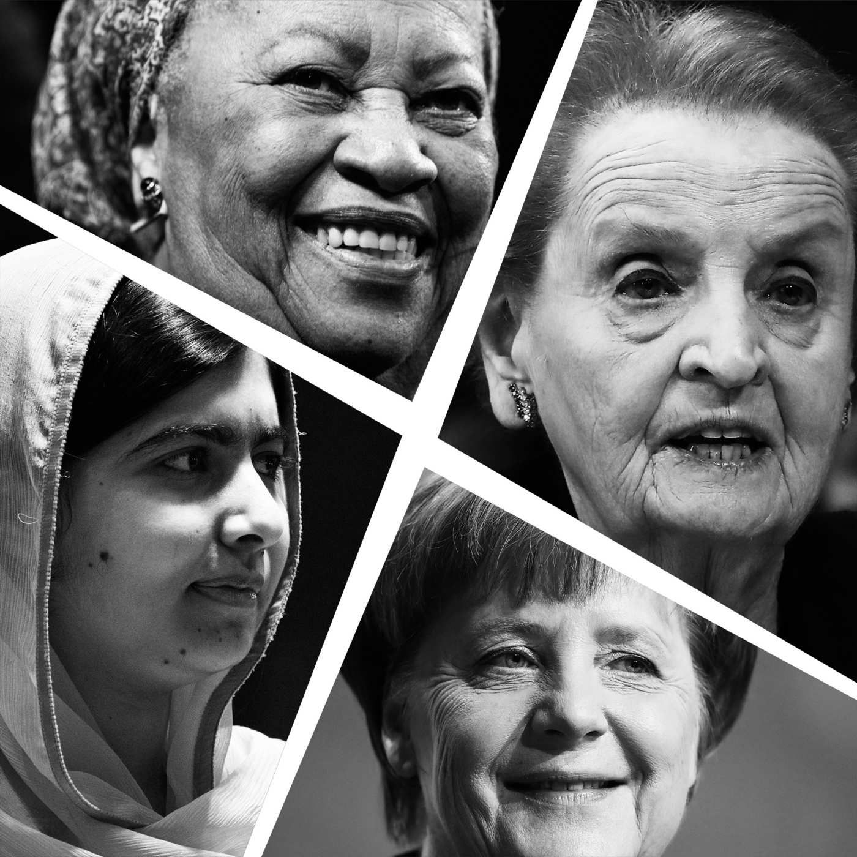

Slide 14
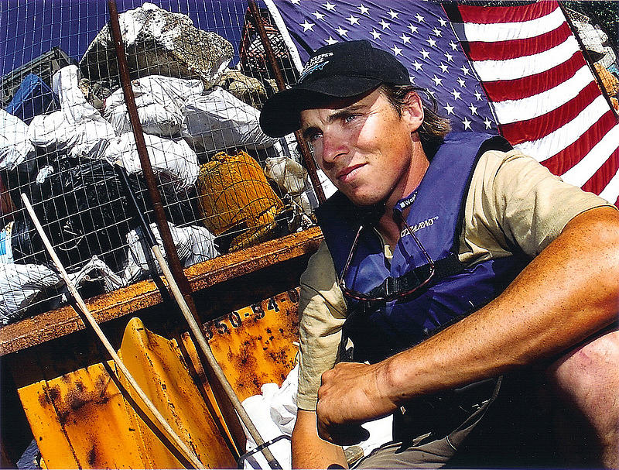
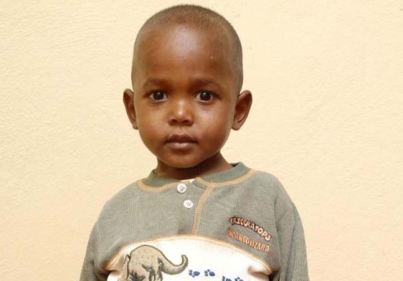

Slide 15
LEADERSHIP FUNDAMENTALS
Leadership is everyone’s business.
“Leadership is Influence, nothing more, nothing less”
John Maxwell
Notes:
Leadership is everyone’s business –Anyone can choose to lead. Anyone can choose to engage in the behaviors of leadership and in so doing influence people, the work environment, the customer experience and profits.
Leadership is about relationships - John Maxwell says “Leadership is not about titles, positions or flowcharts, it’s about one life influencing another.” It is the relationships we establish that allow us to lead others.
Leaders are the best learners – Leadership is a skills you can build and hone through practices, coaching and practice.
It take practice to become a better leader – As you work through the model we will be covering over the next couple of days you will have to practice many of the skills. You will need to make your workplace a research lab learning which behaviors have the most impact with your team.
Leadership is an Aspiration and a Choice – No-one can force you to become a leader, it takes a conscious choice to become an great leader. You will have to choose to treat others with dignity and respect and you will have to choose to work on the challenges of today while preparing for the challenges of tomorrow.

Slide 16
Tariku from Ethiopia
Notes:
A Little “v” Vision is like Tariku’s vision of clean water in his village. Tariku was adopted from Ethiopia when he was 4 by one of the Leadership Challenge Certified Masters, Amy Savage.

Slide 17
Notes:
In his family, it was Tariku, his mother who would go to get water, much like this photo (not Tariku in the photo). They would hike daily to the local water source, which was also source for the livestock. They’d boil it and use it for bathing and cooking.
Tariku’s little brother died of dysentery due to the lack of clean water.

Slide 19
LEADERSHIP FUNDAMENTALS
Leadership is everyone’s business.
Leadership is a relationship.
The best leaders are the best learners.
It takes practice to become a better leader.
Leadership is an aspiration and a choice.
Notes:
Leadership is everyone’s business –Anyone can choose to lead. Anyone can choose to engage in the behaviors of leadership and in so doing influence people, the work environment, the customer experience and profits.
Leadership is about relationships - John Maxwell says “Leadership is not about titles, positions or flowcharts, it’s about one life influencing another.” It is the relationships we establish that allow us to lead others.
Leaders are the best learners – Leadership is a skills you can build and hone through practices, coaching and practice.
It take practice to become a better leader – As you work through the model we will be covering over the next couple of days you will have to practice many of the skills. You will need to make your workplace a research lab learning which behaviors have the most impact with your team.
Leadership is an Aspiration and a Choice – No-one can force you to become a leader, it takes a conscious choice to become an great leader. You will have to choose to treat others with dignity and respect and you will have to choose to work on the challenges of today while preparing for the challenges of tomorrow.

Slide 20
LEADERSHIP
“The art of mobilizing others to want to struggle for shared aspirations.”
Jim Kouzes and Barry Posner
Notes:
What jumps out at you concerning this definition:
Art – Something that can be improved on, is unique to each individual.
Want – People do want to be part of something bigger.
Struggle – People are willing to struggle for those things they deem important enough to do so for.

Slide 21
THE FIVE PRACTICES
MODEL
the Way
ENCOURAGE
the Heart
INSPIRE
a Shared
Vision
ENABLE
Others to
Act
CHALLENGE
the Process

Slide 22
MODEL THE WAY

Slide 23
MODEL THE WAY
Clarify values by finding your voice and affirming shared values.
Set the example by aligning actions with shared values.

Slide 24
If you don’t believe the messenger
You won’t believe the message

Slide 25
If you don’t believe in the messenger, you won’t believe the message.
You can’t believe in the messenger if you don’t know what the messenger believes.
You can’t be the messenger until you’re clear about what you believe.
Notes:
Page 44 of The Leadership Challenge Book, Jim and Barry say “People expect their leaders to speak out on matters of values and conscience. But to speak out, you have to know what to speak about. To stand up for your beliefs, you have to know the beliefs you stand for. To walk the talk, you have to have a talk to to walk. To do what you say, you have to know what you want to say. To earn and sustain personal credibility, you must first be able to clearly articulate deeply held beliefs.”

Slide 26
CHAD PREGRACKE

Slide 27
From Robert Herzog CFO - Harrison College
“You are
your calendar.”

Slide 28
ALIGN WITH VALUES
Calendars
Checkbook
Stories
Language
Measurements
Rewards

Slide 29
FROM VALUES TO VISION
Leadership Philosophy
Personal Values

Slide 30
INSPIRE A SHARED VISION

Slide 31
INSPIRE A SHARED VISION
Envision the future by imagining exciting and ennobling possibilities.
Enlist others in a common vision by appealing to shared aspirations.

Slide 32
Notes:
Vision Signature Story

Slide 33
If change is not connected to a higher purpose,
why should we invest ourselves?
People commit to CAUSES, not PLANS.
Notes:
Reference TLC Book p. 121

Slide 34
“I have a list of measurable objectives”
Notes:
r

Slide 35
“I have a dream”
Notes:
r

Slide 36
CHALLENGE THE PROCESS
Notes:
t

Slide 37
CHALLENGE THE PROCESS
Search for opportunities by seizing the initiative and by looking outward for innovative ways to improve.
Experiment and take risks by constantly generating small wins and learning from experience.
Notes:
t

Slide 38
OUTSIGHT
Being open
Staying in touch
Stepping outside boundaries
Notes:
r

Slide 39
Don Schoendorfer

Slide 40
ENABLE OTHERS TO ACT

Slide 41
ENABLE OTHERS TO ACT
Foster collaboration by building trust and facilitating relationships.
Strengthen others by increasing self-determination and developing competence.
Notes:
a

Slide 42
CAPTAIN D. MICHAEL ABRASHOFF
“If all you do is give orders, then all you will get is order takers.”
Notes:
Optional, but a quick easy story.

Slide 43
Part of Enabling others to act… Is giving Your power away.

Slide 44
ENCOURAGE THE HEART
Notes:
Introduce the Practice and the Commitments.
What does it mean to Encourage the Heart?

Slide 45
ENCOURAGE THE HEART
Recognize contributions by showing appreciation for individual excellence.
Celebrate the values and victories by creating a spirit of community.

Slide 46
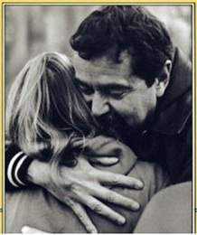
THE POWER OF ENCOURAGE
Too often we underestimate the power of a touch, a smile, a kind word, a listening ear, an honest compliment, or the smallest act of caring, all of which have the potential to turn a life around.
- Leo Buscaglia

Slide 47
ENCOURAGE ONE ANOTHER
What did/do you do for me?
Why is it important?
Thank them in a creative way!

Slide 48
ENCOURAGE ONE ANOTHER NOW
Take Out Your Encouragement Engagement Device (EED) (Cell Phone)
Text someone right now that you would like to encourage
Thank You
Hang In There
???

Slide 49
The Leadership Challenge: Refining & Shaping Culture
The Leadership Challenge
One-on-One
Coaching
One Day Leadership Challenge Follow-Up
LPI Re-Assess & Graduation
Trios &
Reinforcers
Weekly Newsletter
Book Clubs
Formal
Awards Programs
Informal Recognition
Webinars

Slide 50
Thank You for Your Time Have a Great Day
Leadership Development that Endures
https://www.ileadusa.com/

