Slide 1
Supported Decision-Making:
Maximizing Self-Determination and Safety
Jonathan Martinis
Legal Director, Quality Trust for Individuals with Disabilities
Project Director,
National Resource Center for Supported Decision-Making

Slide 2
There ARE Stupid Questions
What’s Your Favorite Right?

Slide 3
Rights=Choice
"I am my choices. I cannot not choose. If I do not choose, that is still a choice. If faced with inevitable circumstances, we still choose how we are in those circumstances.”
- Jean Paul Sartre

Slide 4
Rights=Choice
Choice=Self-Determination
Life control
People’s ability and opportunity to be “causal agents . . . actors in their lives instead of being acted upon”
- Wehmeyer, Palmer, Agran, Mithaug, & Martin, 2000

Slide 5
Benefits of Self-Determination
People with greater self determination are:
Healthier
More independent
More well-adjusted
Better able to recognize and resist abuse
- Khemka, Hickson, & Reynolds, 2005; O’Connor & Vallerand, 1994; Wehmeyer & Schwartz, 1998

Slide 6
Another Stupid Question
Are Your Rights Worth ANYTHING If You’re Not Allowed to Use Them?

Slide 7
And Yet: 2,000 Years and Counting
Ancient Rome: “Curators” appointed for older adults and people with disabilities.
5th Century Visigothic Code: “people insane from infancy or in need from any age . . . cannot testify or enter into a contract“
Feudal Britain: divided people with decision-making challenges into “idiots” and “lunatics” and appointed “committees” to make their decisions

Slide 8
Guardianship In The US
“Plenary” or “Full” Guardianship
Gives the Guardian power to make ALL decisions for the person.
Used in the vast majority of cases
- Teaster, Wood, Lawrence, & Schmidt, 2007.
“As long as the law permits plenary guardianship, courts will prefer to use it.”
- Frolik, 1998

Slide 9
As A Result
Guardians have “substantial and often complete authority over the lives of
vulnerable [people].”
4 NAELA J. 1, 7 (2008).
This includes power to make the most basic health, personal, and financial decisions.
AARP, Guardianship Monitoring: A National Survey of Court Practices 1-2 (2006).

Slide 10
As We’ve Known For Forty Years
When denied self-determination, people:
“[F]eel helpless, hopeless, and self-critical” - Deci, 1975.
Experience “low self-esteem, passivity, and feelings of inadequacy and incompetency,” decreasing their ability to function
- Winick, 1995

Slide 11
The Problem
“The typical ward has fewer rights than the typical convicted felon . . . . By appointing a guardian, the court entrusts to someone else the power to choose where they will live, what medical treatment they will get and, in rare cases, when they will die. It is, in one short sentence, the most punitive civil penalty that can be levied against an American citizen.”
- House Select Committee on Aging, H.R. Rpt. 100-641 (opening statement of Chairman Claude Pepper)

Slide 12
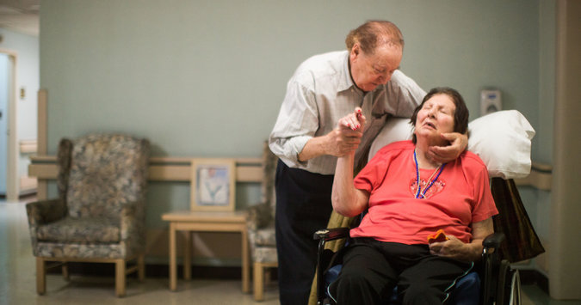
Dino and Lillian
“To Collect Debts, Seizing Control Over Patients” New York Times, 1/25/15

Slide 13
Dino and Lillian
Married over 45 years
Worked together to develop Powers of Attorney and Advanced Directives
When Lillian developed dementia, chose a nursing home for her

Slide 14
Dino and Lillian
After Dino asked questions about a bill and Lillian’s care
Nursing Home petitioned for a plenary guardianship - giving ALL decision-making rights to a stranger
Nursing Home’s attorney: “[G]uardianship is a legitimate means to get the nursing home paid.”

Slide 15
Where Do We Go From Here?
Guardianship MAY be Needed:
In emergency situations when
  The person is incapacitated and cannot give consent
  The person did not previously identify how decisions should be made in that situation
  There is no one else available in the person’s life to provide consent through a Power of Attorney, Advanced Directive, or other means
To support People:
  Who face critical decisions and have no interest in or ability to make decisions
  Who need immediate protection from exploitation or abuse

Slide 16
Guardianship Is NEVER Needed
JUST
“Because you have ___”
“Because you’re ___ years old”
“Because you need help”
“Because that’s the way its always been”
“For your own good”

Slide 17
But We Meant Well
“Experience should teach us to be most on our guard to protect liberty when the Government’s purposes are beneficent. . . . The greatest dangers to liberty lurk in insidious encroachment by men of zeal, well-meaning but without understanding.”
Olmstead v. U.S., 277 U.S. 438 (1928)

Slide 18
We Must’ve Meant REALLY Well
Estimated number of adults under guardianship has tripled since 1995
- Reynolds, 2002; Schmidt, 1995; Uekert & Van Duizend, 2011

Slide 19
Research
People under guardianship can experience a “significant negative impact on their physical and mental health, longevity, ability to function, and reports of subjective well-being”
- Wright, 2010

Slide 20
On The Other Hand
Older adults who exercise more control over their lives have a better quality of life.
Mallers, et al., 2014
Providing support to people with dementia can lead to them being able to provide informed consent.
Haberstroh, et al. 2014

Slide 21
And
People with disabilities who exercise greater self-determination have a better quality of life, more independence, and more community integration.
- Powers et al., 2012; Shogren, Wehmeyer, Palmer, Rifenbark, & Little, 2014; Wehmeyer and Schwartz, 1997; Wehmeyer & Palmer, 2003

Slide 22
And
Women with intellectual disabilities exercising more self-determination are less likely to be abused
- Khemka, Hickson, and Reynolds, 2005

Slide 23
So, Where DO We Go From Here?
If:
We KNOW that some people need more support as they age or due to disability
We KNOW that guardianship can result in decreased quality of life and
We KNOW that increased self-determination leads to improved quality of life
Then we need a means of INCREASING self-determination while STILL providing support

Slide 24

Margaret “Jenny” Hatch
Margaret “Jenny” Hatch
Twenty-Nine year old woman
with Down syndrome.
High School graduate
Lived independently
Employed for 5 years
Politically active

Slide 25
The Situation: February 2013
Court Order putting Jenny in a “temporary guardianship”
Living in a segregated group home
No cell phone or computer, Facebook password changed
Guardians controlled all access to her
Working up to 5 days a week for 8 months – made less than $1000

Slide 26
Court Ordered “Temporary Guardianship”
Guardians had the power:
“[T]o make decisions regarding visitation of individuals with Respondent, Respondent's support, care, health, safety, habilitation, education, therapeutic treatment and, if not inconsistent with an order of commitment, residence.”

Slide 27
Why?
From Their Expert
On Jenny’s:
Independent Living Skills: “If she had assistance, she may be able to do that”
Legal Skills: “she would need assistance to understand a legal document”
Money Management: She needs “assistance with [a] bank account.”

Slide 28
Therefore…
“She’s going to need assistance to make decisions regarding her healthcare, her living arrangements and such like that, she will need someone to guide her and give her assistance.”

Slide 29
Petitioners’ Sworn Statement
How could Jenny execute a Power of Attorney?
“[N]ot only did Jenny have an opportunity to review the documents, but also the attorney had the opportunity to get to know Jenny and understand her capabilities and limitations in understanding legal documents. Based on this series of observations over several visits, the attorney concluded, and we concurred, that Jenny was capable of understanding these documents.”

Slide 30
What That All Adds Up To
Jenny Needs Support:
To Understand Legal Issues
To Understand Medical Issues
To Understand Monetary Issues
In her Day to Day Life

Slide 31
In Other Words
JENNY IS A PERSON
We Are All Jenny Hatch

Slide 32
A Way Forward:
Supported Decision-Making
“a recognized alternative to guardianship through which people with disabilities use friends, family members, and professionals to help them understand the situations and choices they face, so they may make their own decisions without the “need” for a guardian.” - Blanck & Martinis, 2015.

Slide 33
Think About It
How do you make decisions?
What do you do if you’re not familiar with the issue?
Taxes?
Medical Care?
Auto Repairs?
What Do You Do?

Slide 34
So, Supported Decision-Making Is A Lot of Words For
Getting help when its needed
Just like you and me

Slide 35
And Just Like You And Me:
Decisions Jenny had made with Support
Sign Power of Attorney
Consent to Surgery
Medicaid Waiver Individual Service Plan
Application for Paratransit
Authorization to share medical records
Assignment of a Representative Payee

Slide 36
Final Order
First 4 pages justify guardianship.
“However”
Guardians to be who she wants
She lives where she wants
Guardianship for only 1 year – Expired August, 2014
Only over 2 things – medical and safety

Slide 37
Final Order
EVEN DURING the 1 year limited guardianship:
“Guardians shall assist Respondent in making and implementing decisions we have termed ‘supported decision making.’“

Slide 38
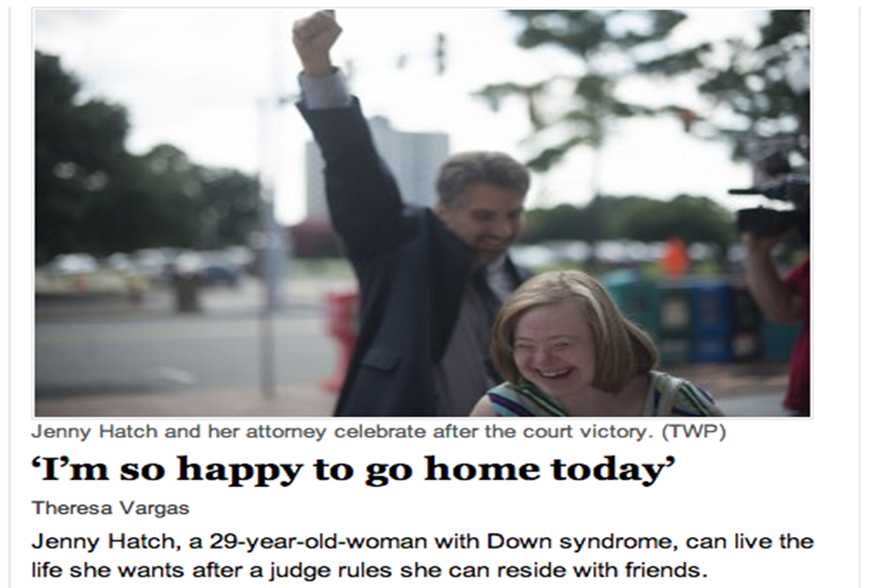
Jenny Got Justice

Slide 39
Why?
Jenny is Strong, Smart, Determined
AND
She had support from:
Friends and professionals
National Organizations and Leaders
Media
A Judge who was willing to Listen and Learn

Slide 40
In Other Words
Jenny Got Lucky

Slide 41
The Lesson Jenny Teaches Us
Justice and Self-Determination should:
NEVER depend on luck or who you know.
ALWAYS Be the Rule NOT the Exception

Slide 42
So, Where Do Go From HERE?:
When Is Guardianship Necessary?
EVERY STATE HAS ITS OWN GUARDIANSHIP LAWS
Example: Wis. Stat. 54.10
Guardianship is ONLY appropriate if:
"The individuals need for assistance in decision making or communication is unable to be met effectively and less restrictively through appropriate and reasonably available training, education, support services, health care, assistive devices, or other means that the individual will accept.”

Slide 43
Another Example:
In Minnesota, guardians can be appointed for people who are “Incapacitated” – “an individual who . . .is impaired to the extent of lacking sufficient understanding or capacity to make or communicate responsible personal decisions, and who has demonstrated deficits in behavior which evidence an inability to meet personal needs”
- Minnesota Code Section 524.5-102
“the respondent's identified needs cannot be met by less restrictive means”
- Minnesota Code Section 524.5-310

Slide 44
Another Example
A person can only be placed under guardianship if s/he is incapacitate:
Utah Code 75-1-201:
(22) “Incapacitated” means “a judicial determination after proof by clear and convincing evidence that an adult’s ability to do the following is impaired to the extent that the individual lacks the ability, even with technological assistance, to meet the essential requirements for financial protection or physical health, safety, or self care:
Receive and evaluate information
Make and communicate decisions
Provide for necessities such as food , shelter, clothing, health care, or safety”

Slide 45
Yet Another
In Missouri a person cannot be placed under guardianship unless s/he is incapacitated:
Missouri Law Chapter 475.010.1, “incapacitated” means:
“is unable by reason of any physical or mental condition to receive and evaluate information or to communicate decisions to such an extent that he or she lacks capacity to meet essential requirements for food, clothing, shelter, safety or other care such that serious physical injury, illness, or disease is likely to occur.”

Slide 46
Think About “Capacity” And “Ability”
People may have “capacity” to make some decisions but not others.
Or be able to make decisions some times but not others.
Or be unable to make decisions unless they get help understanding the decision to be made.
- Salzman, 2010

Slide 47
So…
If a person only has the “capacity” or “ability” to make decisions with assistance or support, is s/he incapacitated?
ARE YOU?

Slide 48
Which Means: ASK A QUESTION
Before seeking or recommending Guardianship:
What Else Have You Tried?

Slide 49
Or, As the National Guardianship Association Says
“Alternatives to guardianship, including supported decision making, should always be identified and considered whenever possible prior to the commencement of guardianship proceedings.”
- National Guardianship Association Position Statement on Guardianship, Surrogate Decision Making and Supported Decision Making, 2015

Slide 50
Supported Decision-Making Can Address Limitations in Decision-Making
Supported Decision-Making can help people:
Understand information, issues, and choices;
Focus attention in decision-making;
Weigh options;
Ensure that decisions are based on their own preferences
Interpret and/or communicate decisions to other parties.
- Salzman, 2011

Slide 51
It’s A Paradigm, Not A Process
There is no “one size fits all” method of Supported Decision-Making.
Can include, as appropriate
Informal support
Written agreements, like Powers of Attorney, identifying the support needed and who will give it
Formal Micro-Boards and Circles of Support
- Martinis, Blanck, and Gonzalez, 2015

Slide 52
In Common
ALL Forms of Supported Decision-Making recognize:
That EVERYONE has The Right to Make Choices to the maximum of their capabilities;
That people can get help exercising their Right to Make Choices without giving up that right; and
There are as many ways to give and get help as there are people
- e.g., Dinerstein, 2012

Slide 53
Supported Decision-Making and Self Determination
“Supported Decision-Making has the potential to increase the self-determination of older adults and people with disabilities, encouraging and empowering them to reap the benefits from increased life control, independence, employment, and community integration”
- Blanck & Martinis, 2015

Slide 54
Many State Laws Already Require It!
Wis. Stat. 54.10 - Guardianship is ONLY appropriate if:
"The individuals need for assistance in decision making or communication is unable to be met effectively and less restrictively through appropriate and reasonably available training, education, support services, health care, assistive devices, or other means that the individual will accept.”
WHAT ELSE HAVE YOU TRIED?

Slide 55
Opportunities for SDM
Are All Around Us
“Informed consent”
“Informed choice”
“Person Centered Planning”
Are ALL forms of SDM!

Slide 56
SDM Opportunity:
Person Centered Planning
It’s REQUIRED in Medicaid HCBS Waiver programs -Final Rules CMS 2249-F and CMS 2296-F
Medicaid Waiver Services MUST address “health and long-term services and support needs in a manner that reflects individual preferences and goals” and
Be Driven by the person
Include people chosen by the person
Give primary consideration to and Include things important to the person

Slide 57
“Life Planning”
“It is my and my agent’s intent that we will work together to implement this [Power of Attorney/Advanced Directive/Agreement/Plan]. That means that I should retain as much control over my life and make my own decisions, with my agents support, to the maximum of my abilities. I am giving my agent the power to make certain decisions on my behalf, but my agent agrees to give primary consideration to my express wishes in the way she makes those decisions.”

Slide 58
SDM Opportunity
Medical Decision-Making
“[M]y agent will work with me to make decisions and give me the support I need and want to make my own health care decisions. This means my agent will help me understand the situations I face and the decisions I have to make. Therefore, at times when my agent does not have full power to make health care decisions for me, my agent will provide support to make sure I am able to make health care decisions to the maximum of my ability, with me being the final decision maker.”

Slide 59
SDM Opportunity
Financial Authority
I will not buy, sell, manage, or otherwise take or exercise any interest in any tangible property or item costing or worth more than $X without my agent’s agreement. For example, if I want to buy or sell a car for $20,000, I would need my agent to agree or the sale could not go through.
In making decisions whether or not to buy, sell, manage, or otherwise take or exercise any interest in any tangible property or item costing or worth more than X, my agent and I will discuss the situation and give consideration to my express wishes before my agent decides whether or not to agree.

Slide 60
The PRACTICAL Method by American Bar Association
PRESUME that guardianship is not needed.
REASONS for concern – “What’s the problem?”
ASK if the problem is temporary or easily addressable- “What’s the root cause?”
COMMUNITY Connect with resources – “What would it take to solve the problem?” and “Who can provide that?”
TEAM Has the person already identified people s/he wants to work with?
IDENTIFY If the person does not have a team, examine abilities, limitations, wants, needs, and contacts to see if a team can be made or supports provided
CHALLENGES Are there potential problems with team members or resources?
APPOINT If the person wants to give someone else the power to support or make decisions, help the person do it consistent with his or her wishes
LIMIT As a last resort, seek a guardianship limited to ONLY those areas the person cannot make decisions with or without support

Slide 61
Always Remember
EVEN IF the person is "Incapacitated" or is being abused or neglected, it does NOT NECESSARILY mean the person NEEDS A GUARDIAN.
It could just be the person needs new or better supports.
REASSESS AND REAPPLY PRACTICAL:
WHAT ELSE HAVE YOU TRIED?

Slide 62
EVEN IF Guardianship is Needed
The National Guardianship Assoc
EVEN IF a guardianship is necessary
“[T]he supported decision-making process should be incorporated as a part of the guardianship”
WHAT ELSE ARE YOU TRYING?

Slide 63
When What You’ve Tried Works
Wisconsin Statute 54.64
“ A ward . . . any person acting on the ward's behalf, or the ward's guardian may petition for a review of incompetency, to have the guardian discharged and a new guardian appointed, or to have the guardianship limited and specific rights restored”

Slide 64
Doesn’t That Mean…
A Guardian’s job is to work with the person:
To help the person learn to make his or her own decisions, with support
To build self-determination
To help the person learn to meet his or her “needs” through “less restrictive” means
And then ask the Court to terminate the guardianship?
Guardianship as a Way-Station, Not a Final Destination

Slide 65
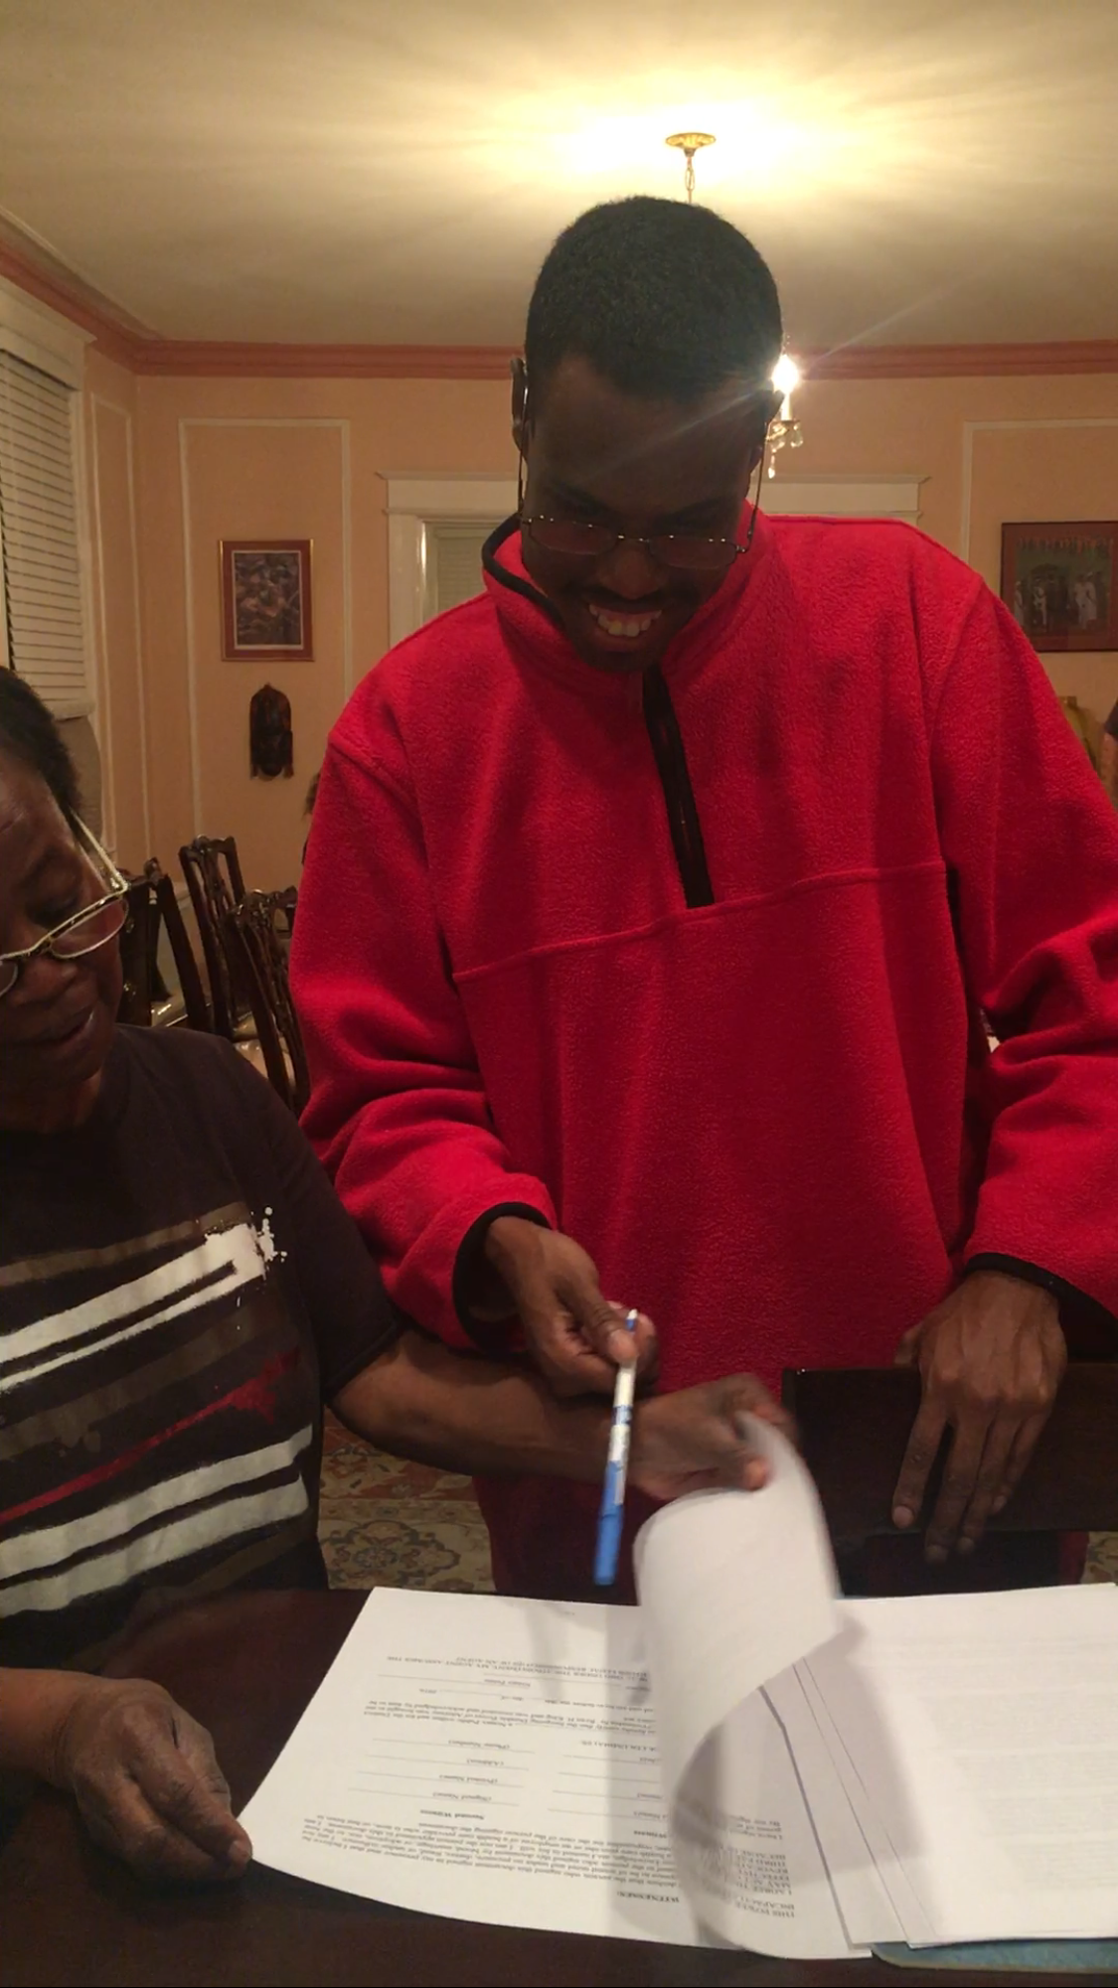
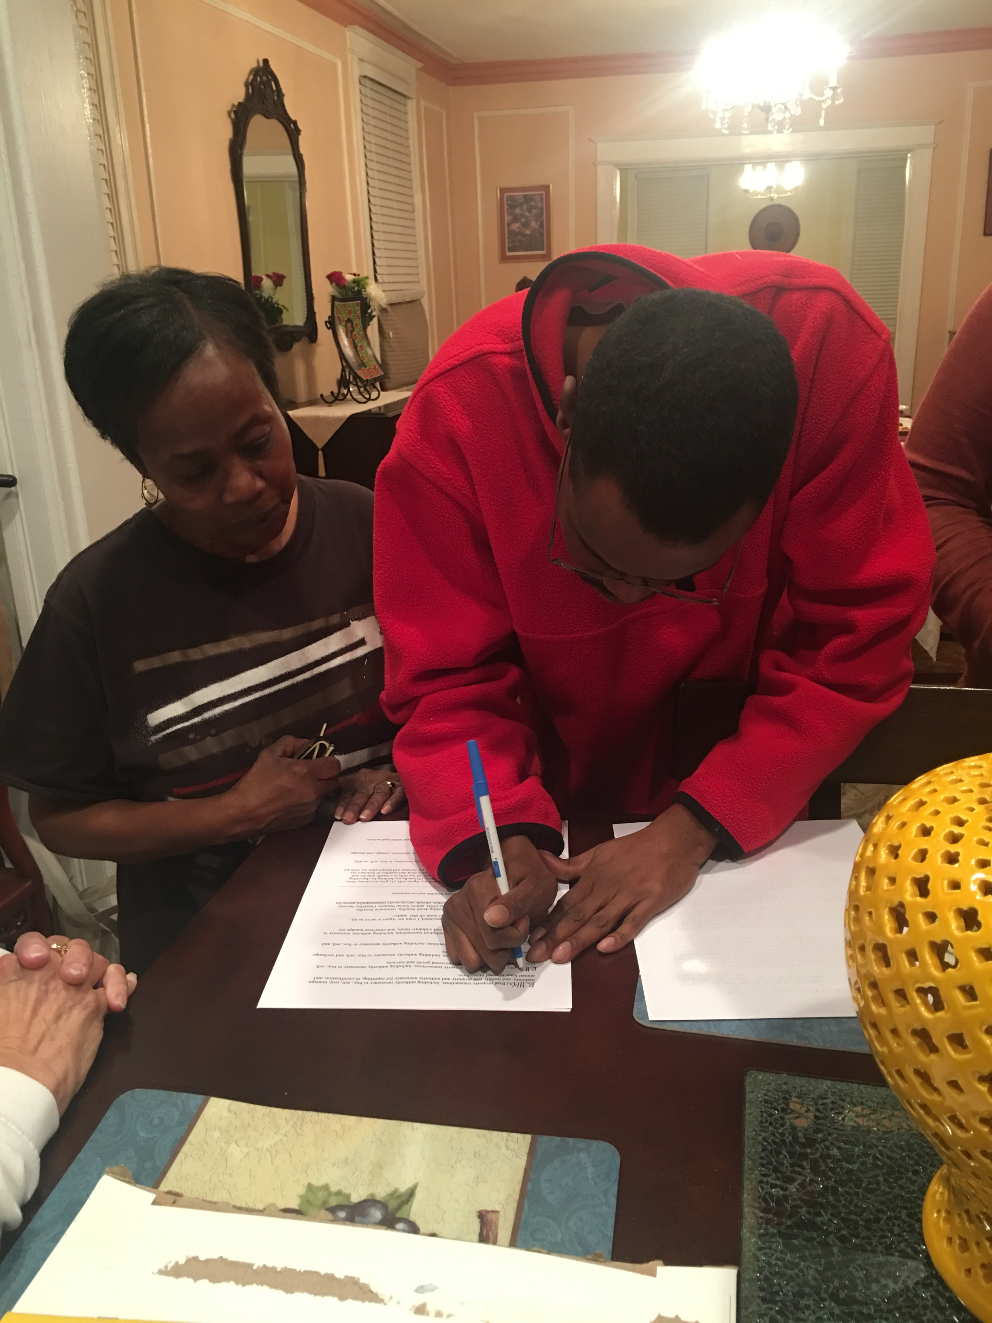
IT CAN HAPPEN

Slide 66
The Elephant In The Room: Safety
NOTHING: Not Guardianship, Not Supported Decision-Making is 100% "Safe."
HOWEVER: Supported Decision-Making Increases Self-Determination (Blanck & Martinis, 2015), which is correlated with increased Safety (Khemka, Hickson, & Reynolds, 2005).

Slide 67
Signs and Signals –Abuse and Neglect
Injuries
Unusual bruising or abrasions
Fear or nervousness
Withdrawal
Basic needs not being met
Overdependence on another
Bills not being paid
Living below means
Things are missing

Slide 68
BUT REMEMBER: Adults Are Allowed to make bad Decisions
Health
Money
Love
Living Conditions

Slide 69
NEVER FORGET:
Dino, Lillian, and Jenny
Supported Decision-Making ONLY works if we recognize, respect, and protect EVERYONE’S
Right to Make Choices.

Slide 70
Remember The Challenge
EVERY great advance in civil rights fundamentally changed the way “things have always been”

Slide 71
Remember The Obstacles
Change is HARD
“We were not promised ease. The purpose of life . . . is not ease. It is to choose, and to act upon the choice. In that task, we are not measured by outcomes. We are measured only by daring and effort and resolve.”
- Stephen R. Donaldson

Slide 72
Remember the Goal
Older adults and People with Disabilities having “the same opportunities for success and security as their nondisabled peers. . . .
If we change the culture, we will change the world!”
Gustin & Martinis, 2016

Slide 73
Join the Conversation
National Resource Center for Supported Decision-Making:
SupportedDecisionMaking.Org
The Burton Blatt Institute at Syracuse University: BBI.Syr.Edu
Jonathan Martinis, Senior Director for Law and Policy: JGMartin@Law.Syr.Edu

